Slide 1
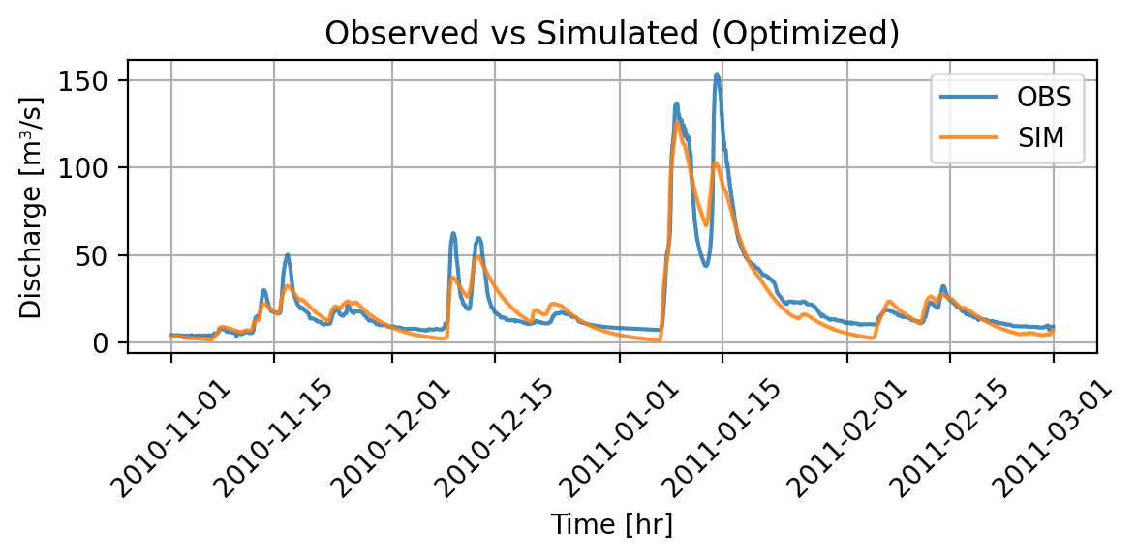
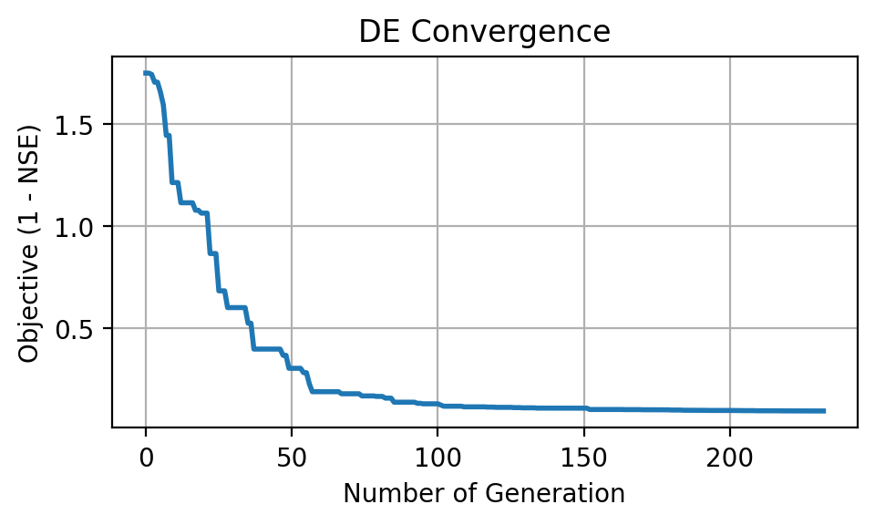
All Parameters on
NSE: 0.901
Runtime: 3.74 min
Max iteration: ~ 100

Slide 2
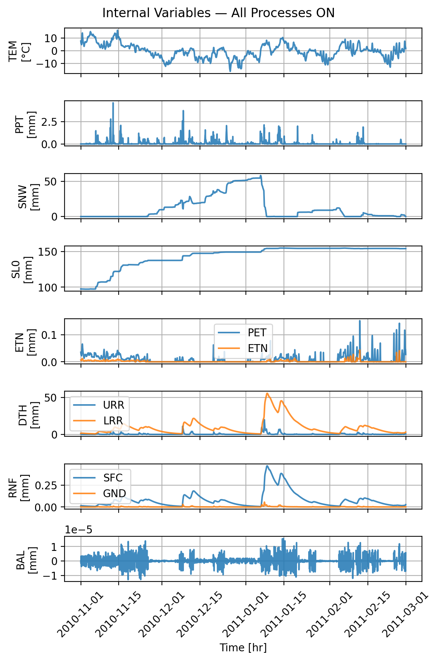
All Parameters on
Snow initial depth: 0.000000
Snow fall/melt temperature: 0.148940
Snow melt air factor: 0.634415
Precipitation melt air factor: 0.036731
Soil initial moisture: 94.568525
Soil permanent wilting point: 432.979200
Soil field capacity: 148.866130
Soil beta: 2.659653
Storage initial upper reservoir: 1.728010
Storage initial lower reservoir: 0.739939
Upper-res. runoff split ratio: 0.748241
Percolation coefficient upper-to-lower: 0.185272
Upper-res. threshold depth: 60.579322
Upper-res. threshold coefficient: 0.143289
Upper-res. discharge to runoff coefficient: 0.000401
Upper-res. Runoff coefficient: 0.000147
Discharge rate: 0.008535
Lower-res. runoff coefficient: 0.000024

Slide 3
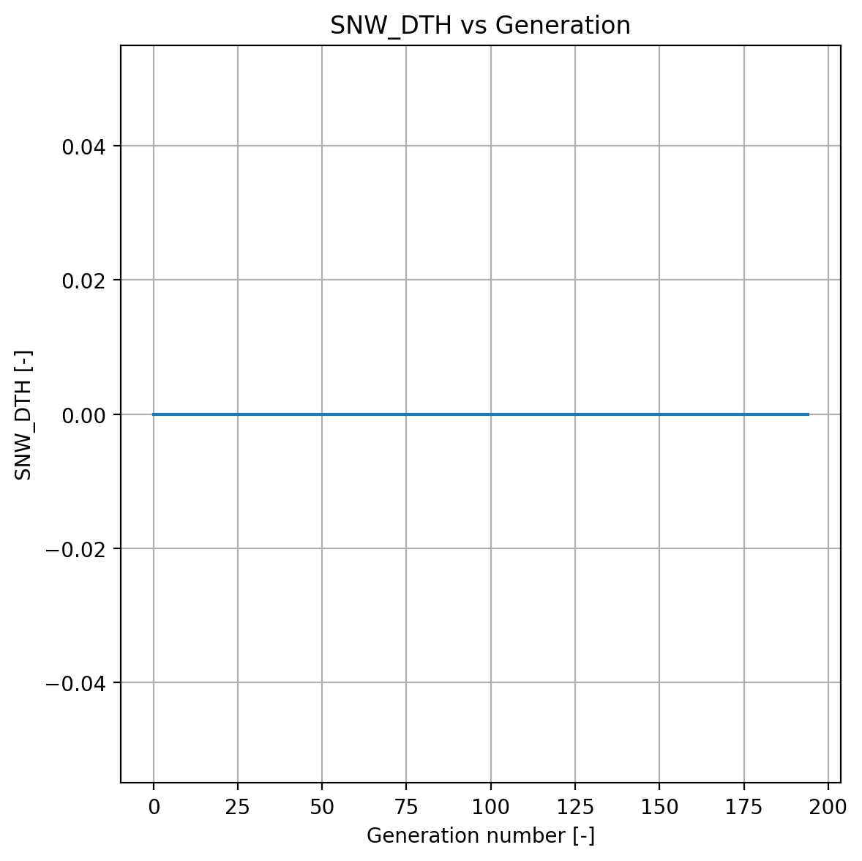
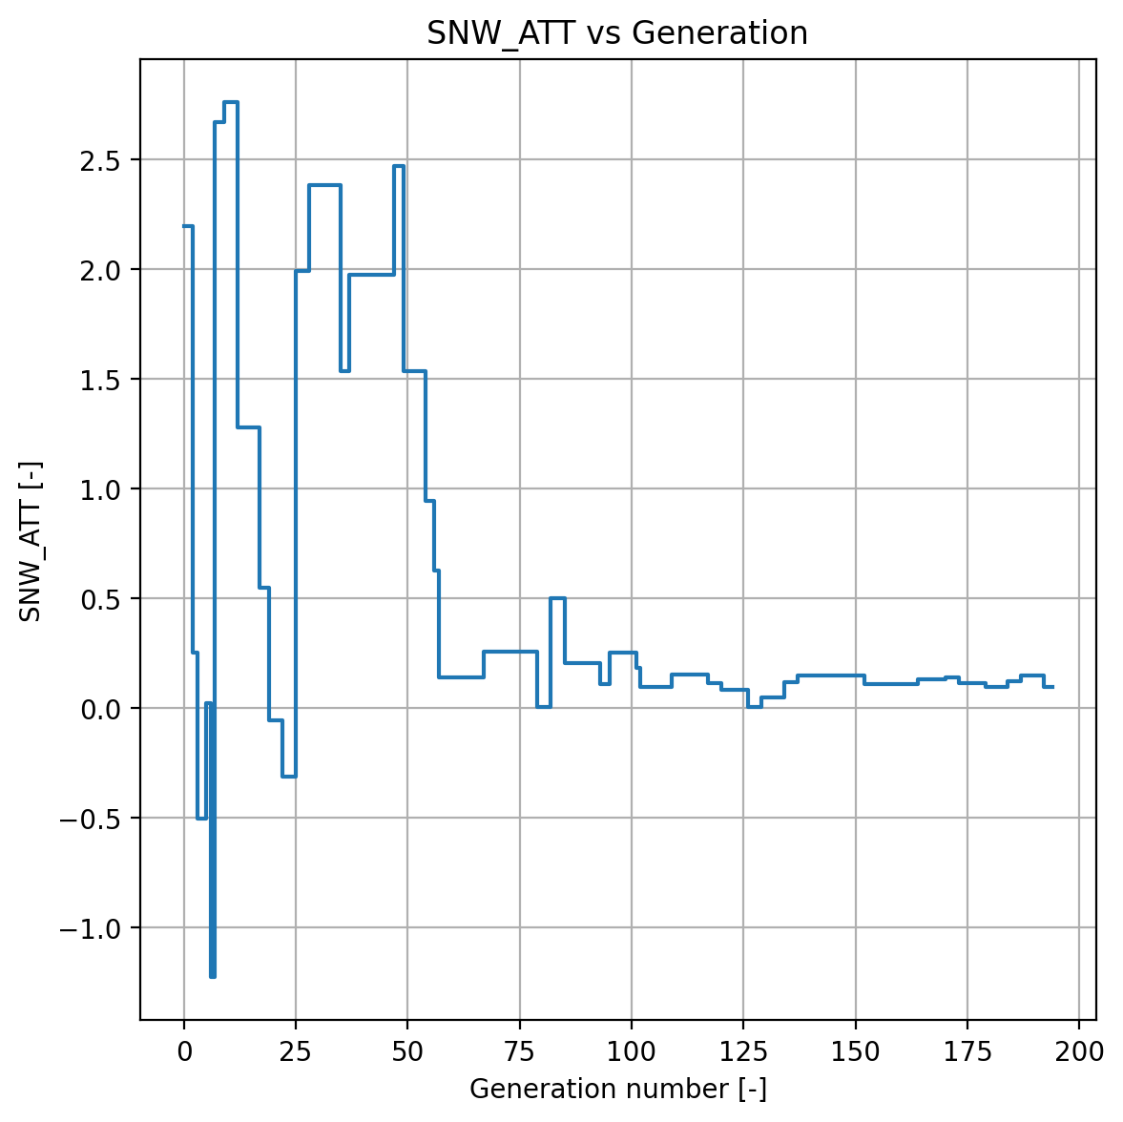
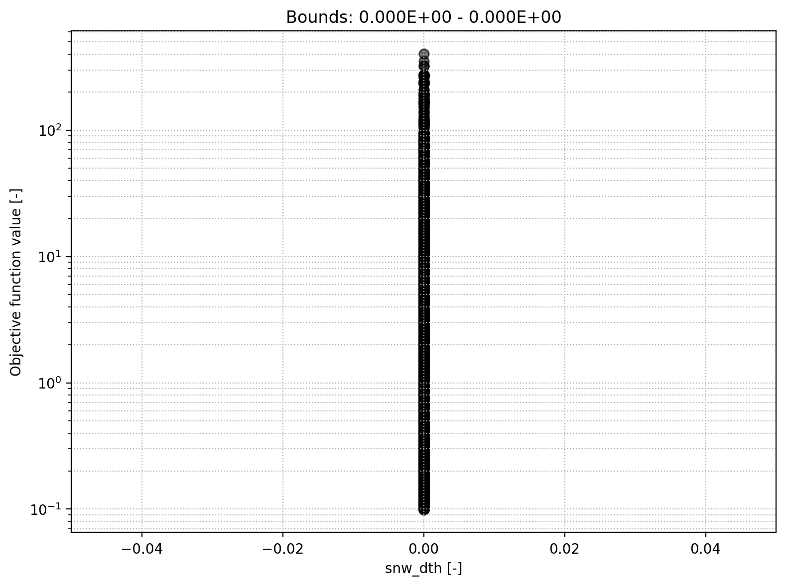
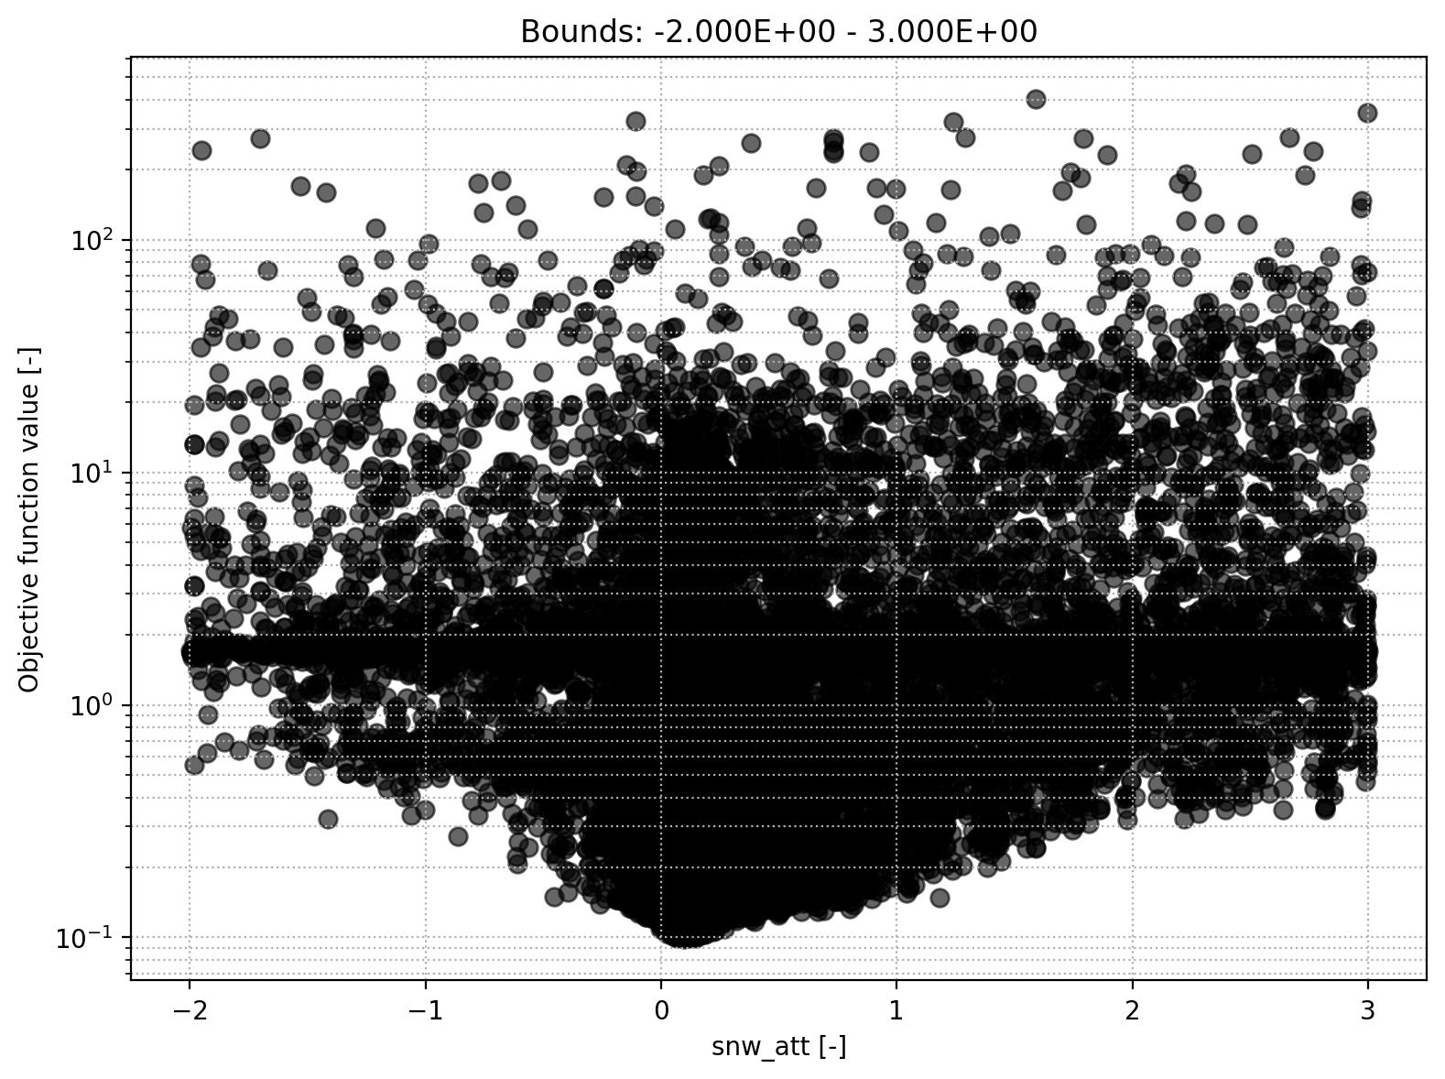
Snow module
Snow initial depth
Snow fall/melt temperature threshold

Slide 4
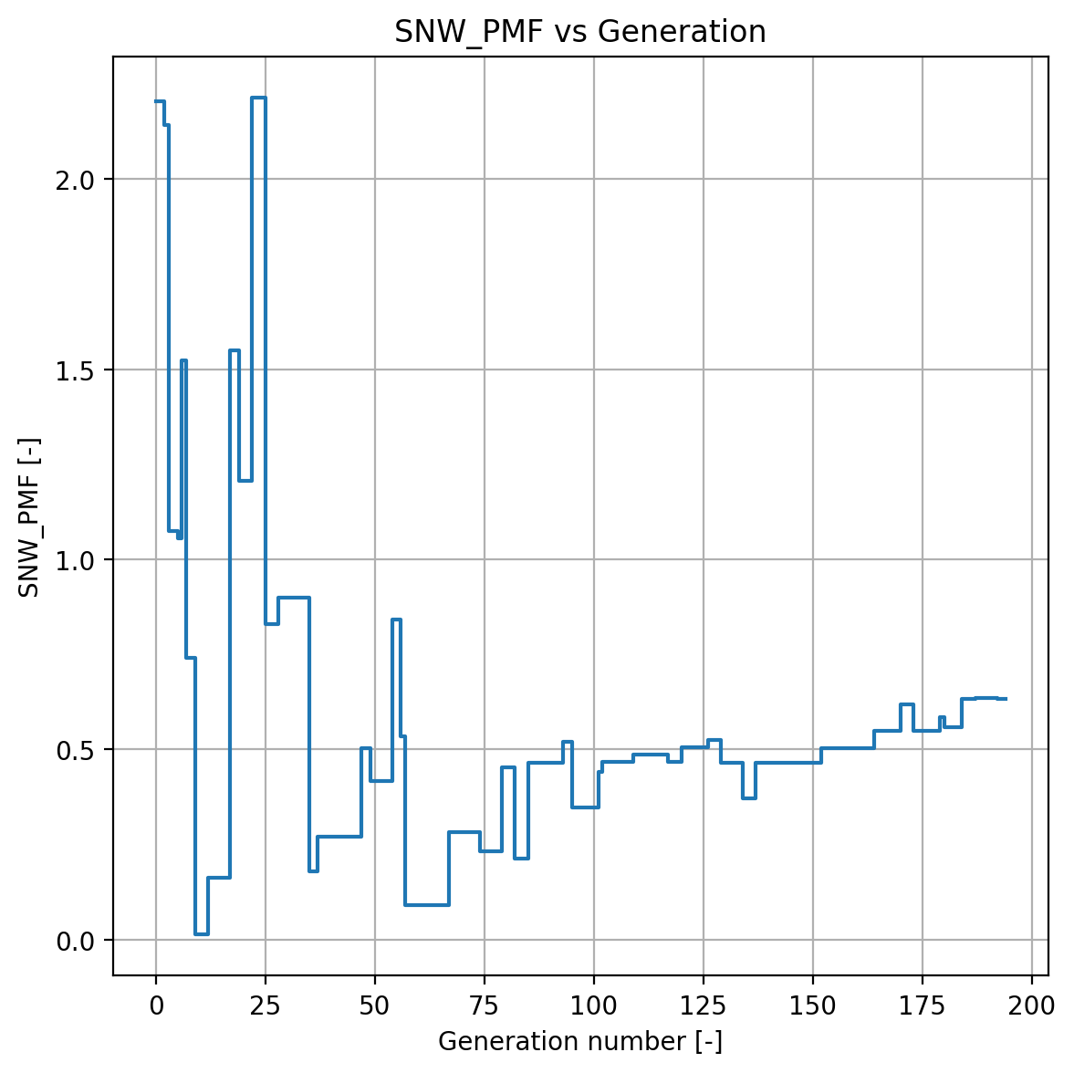
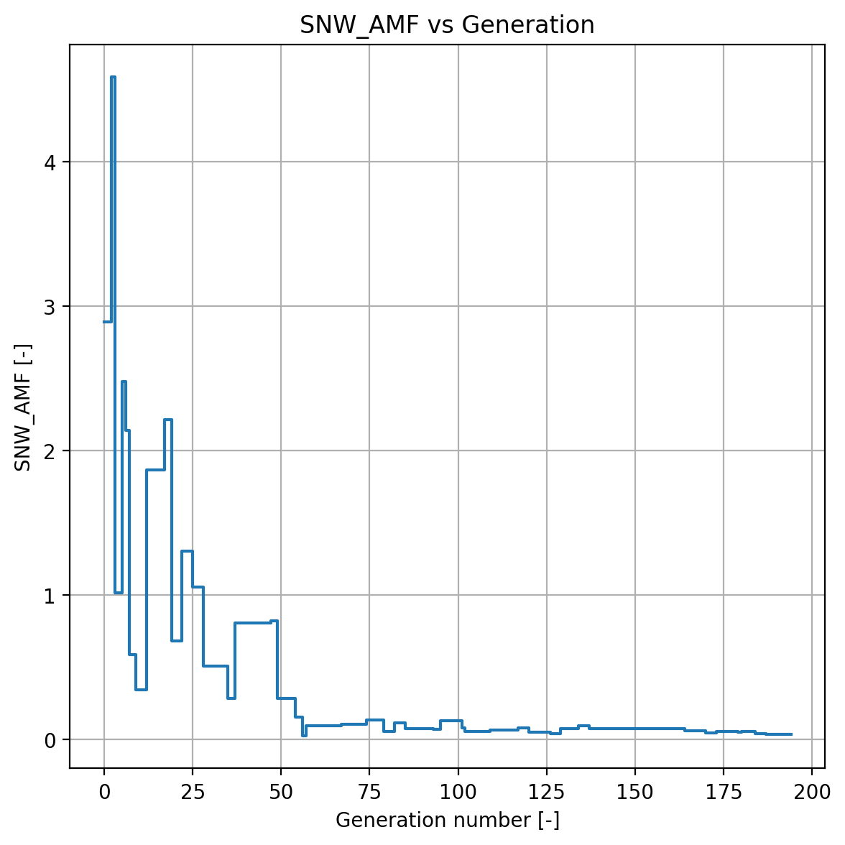
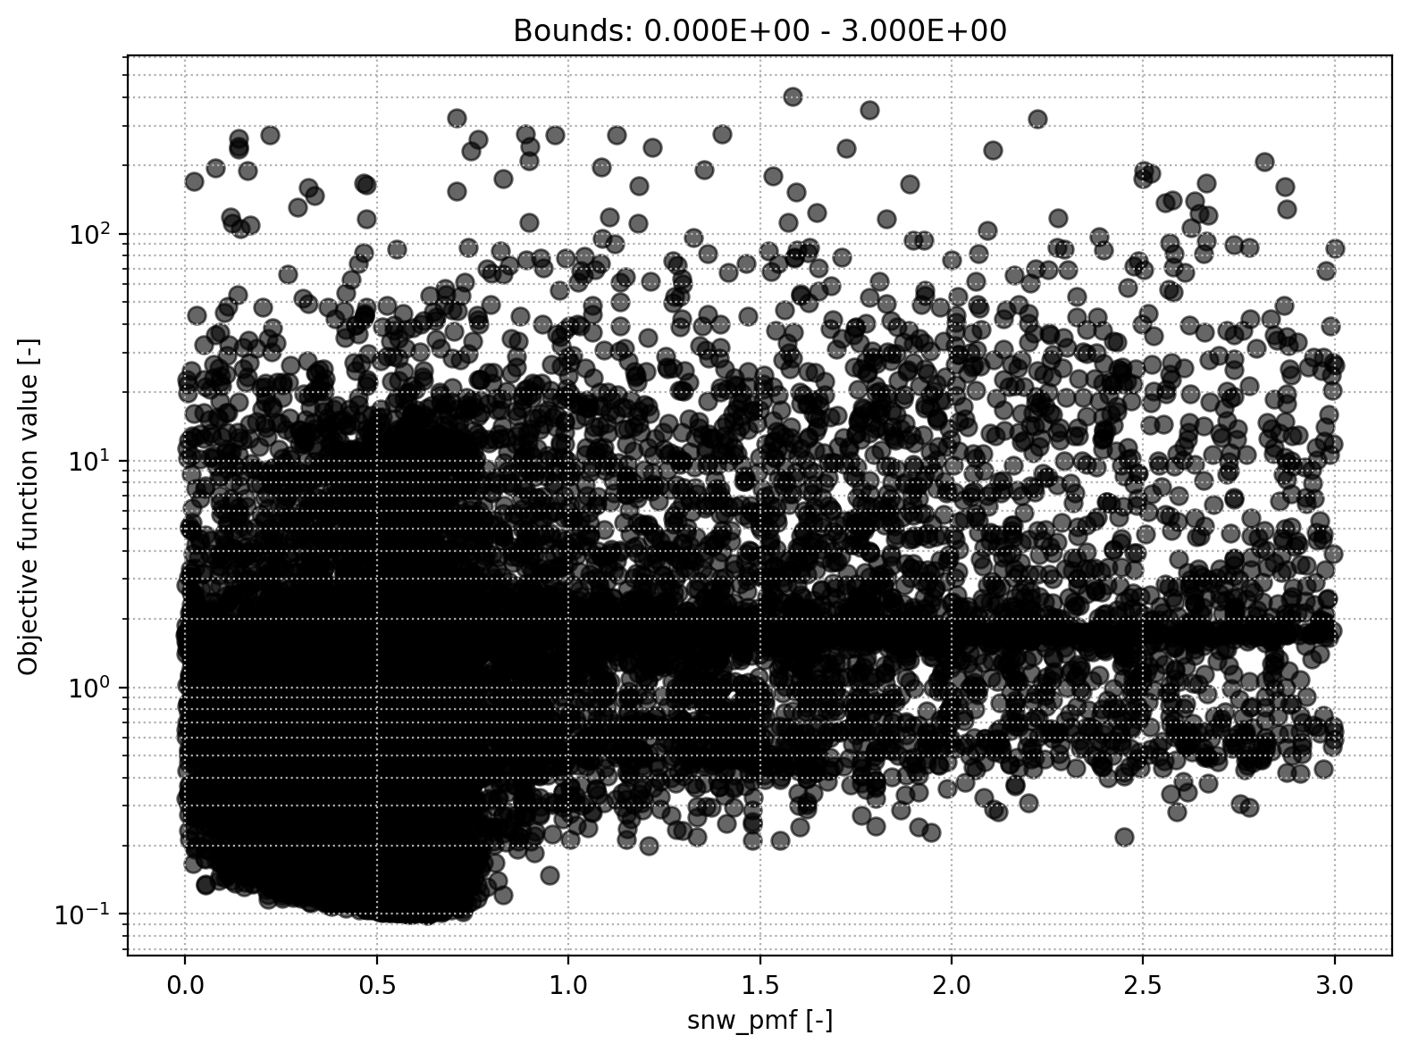
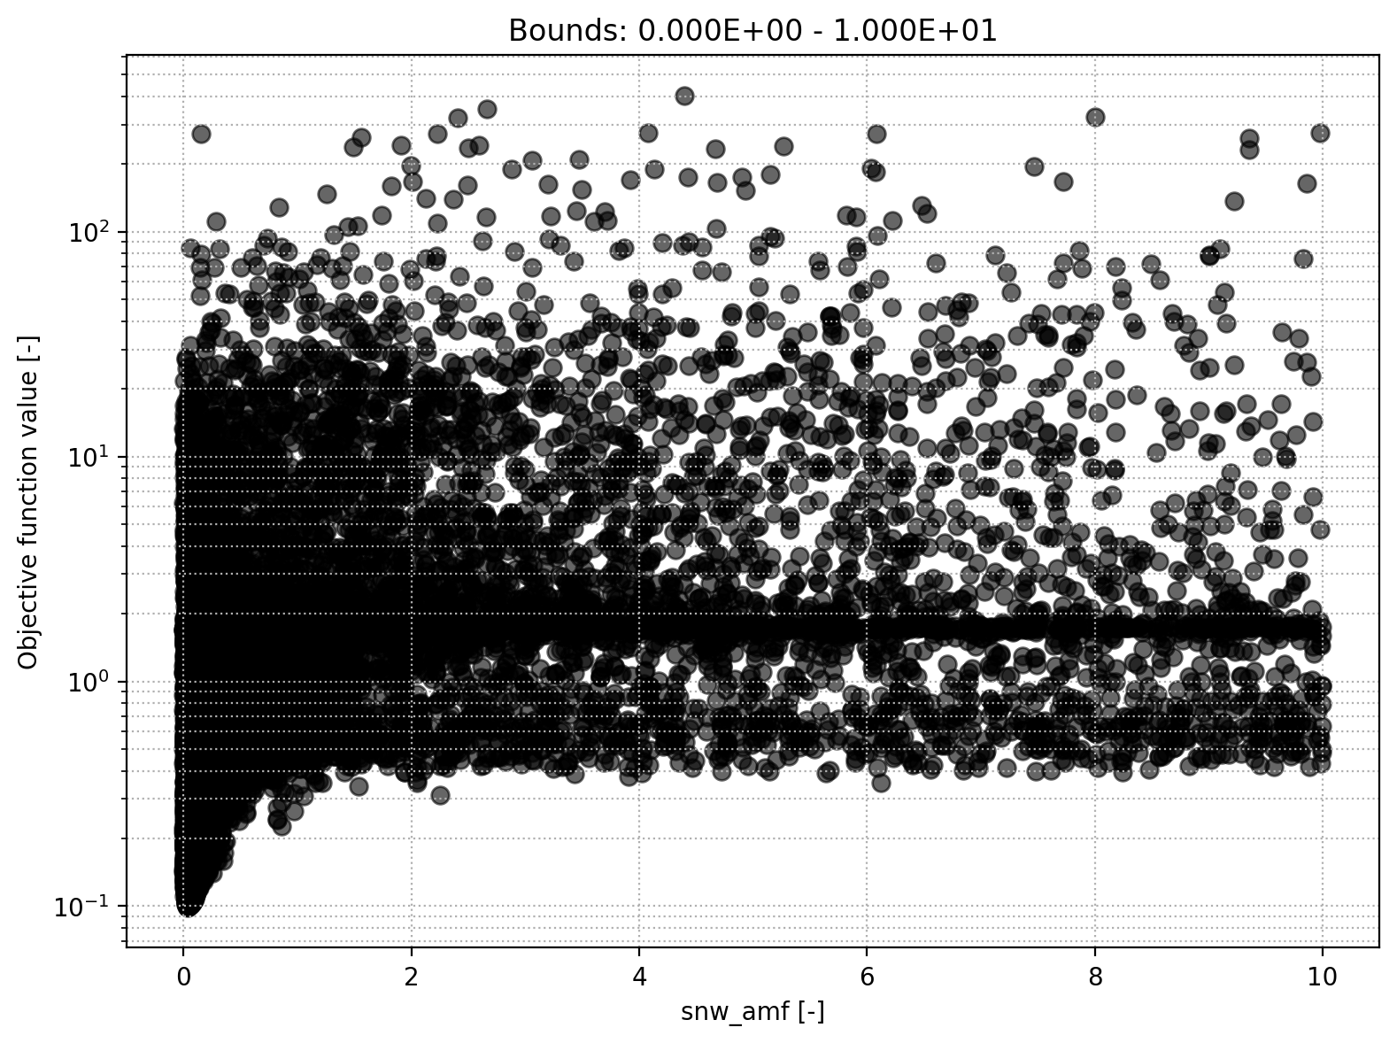
Snow module
Snow melt air factor
Precipitation melt air factor

Slide 5
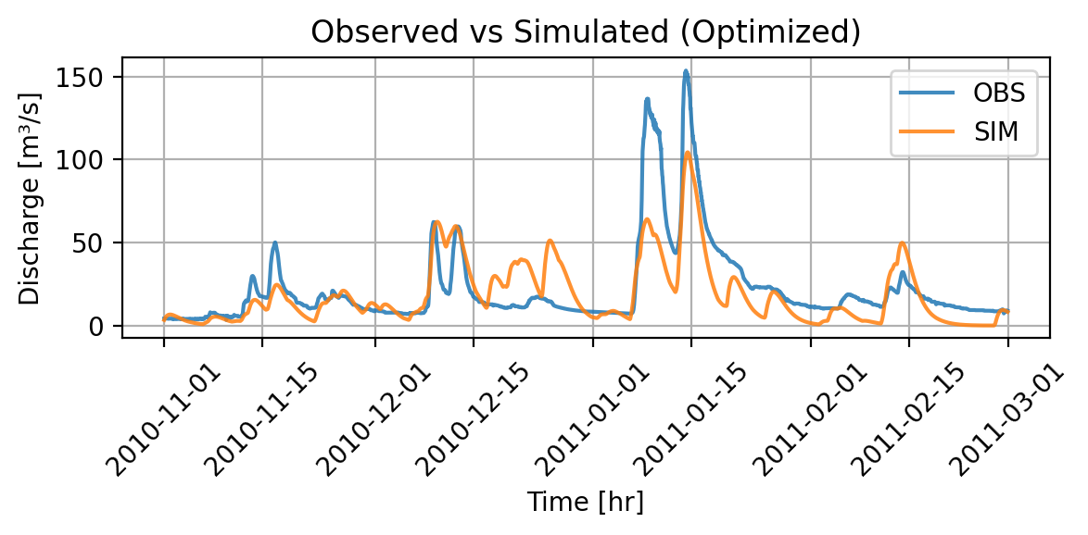

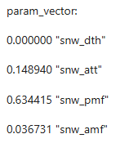
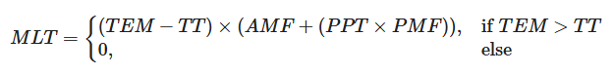
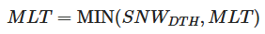
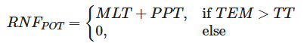
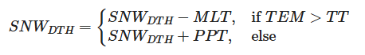
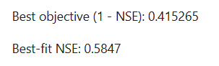
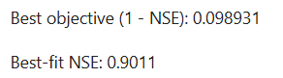
Snow module off – optimization Part 1
We set TT = -100°C
We set AMF = PMF = 0
Adapt bounds and run optimization
Simulated Discharge – snow modul off
Simulated Discharge – all modules on

Slide 6
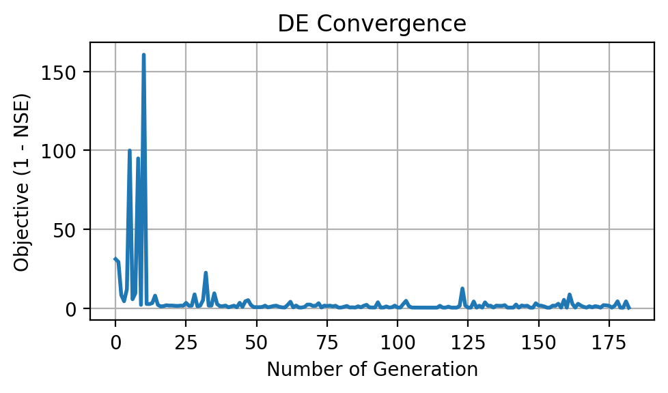
Snow module off – optimization Part 2
Schenkenau in Bavaria -> We expect melt
Less peaky as melt implies higher runoff
Interesting behavior (snow then no snow at fast melt)
High OFV
Poor convergence
Conclusion: Snow module relevant

Slide 7
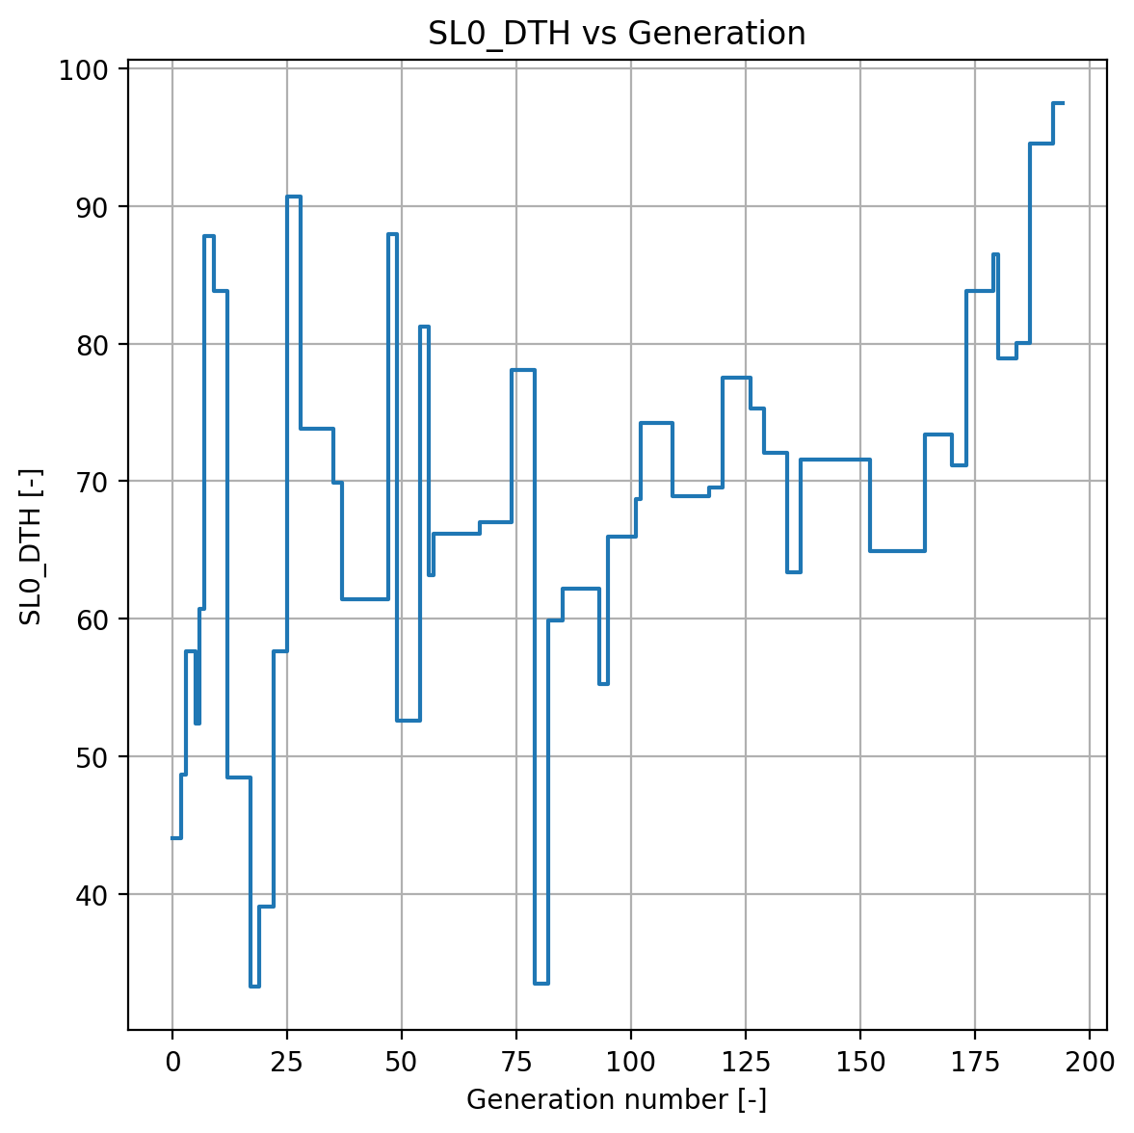
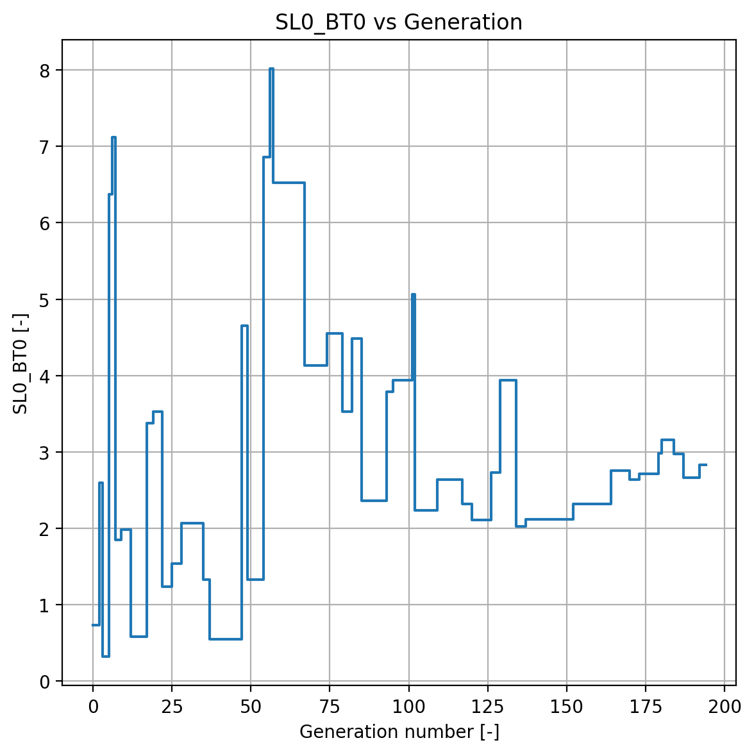
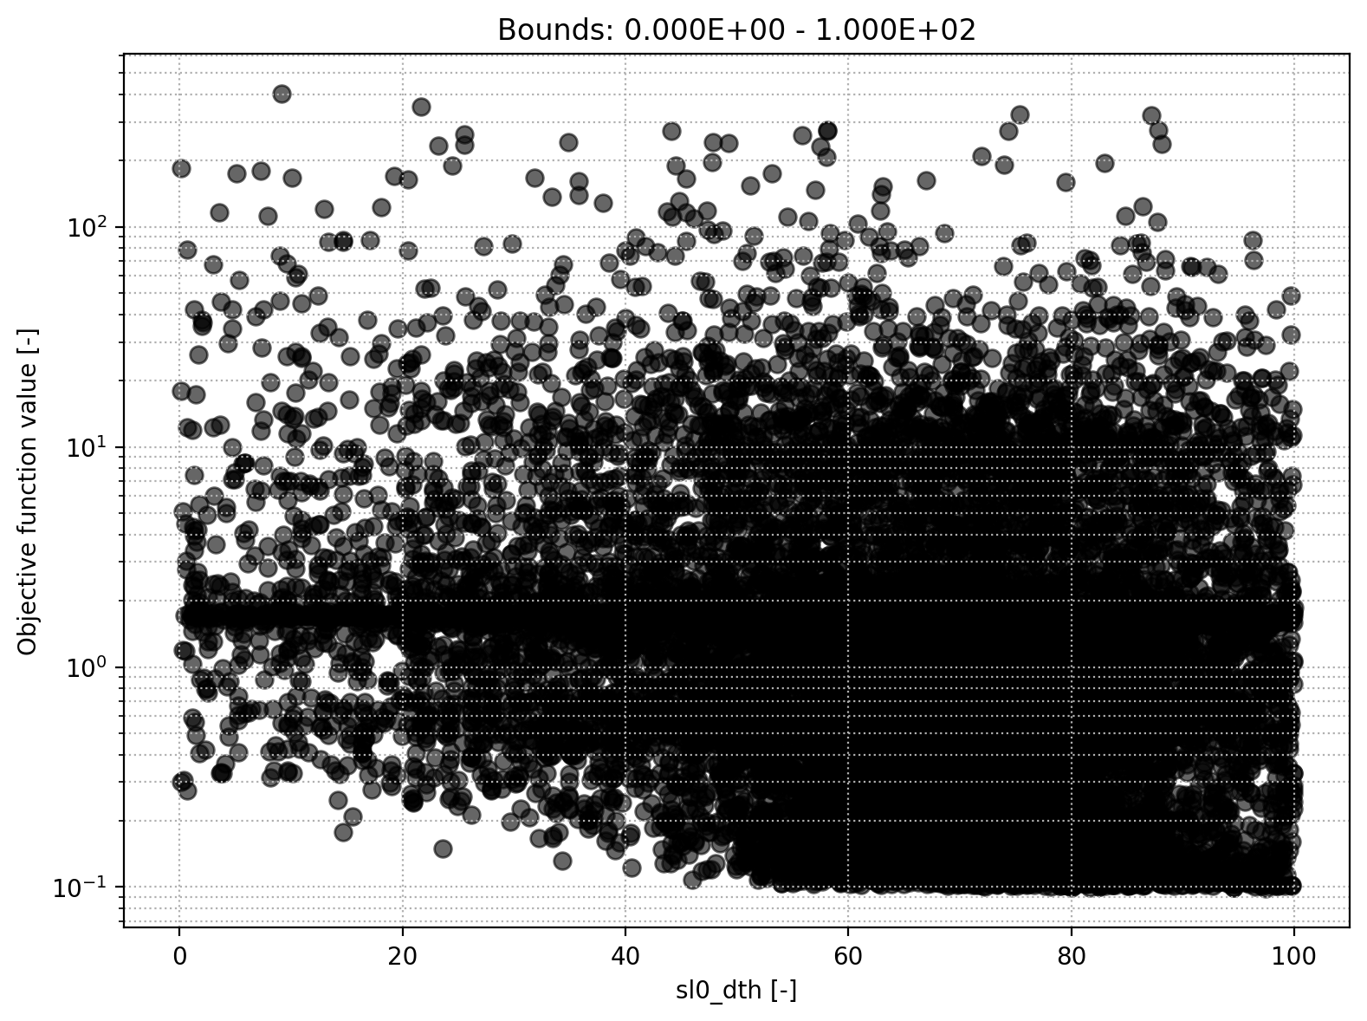
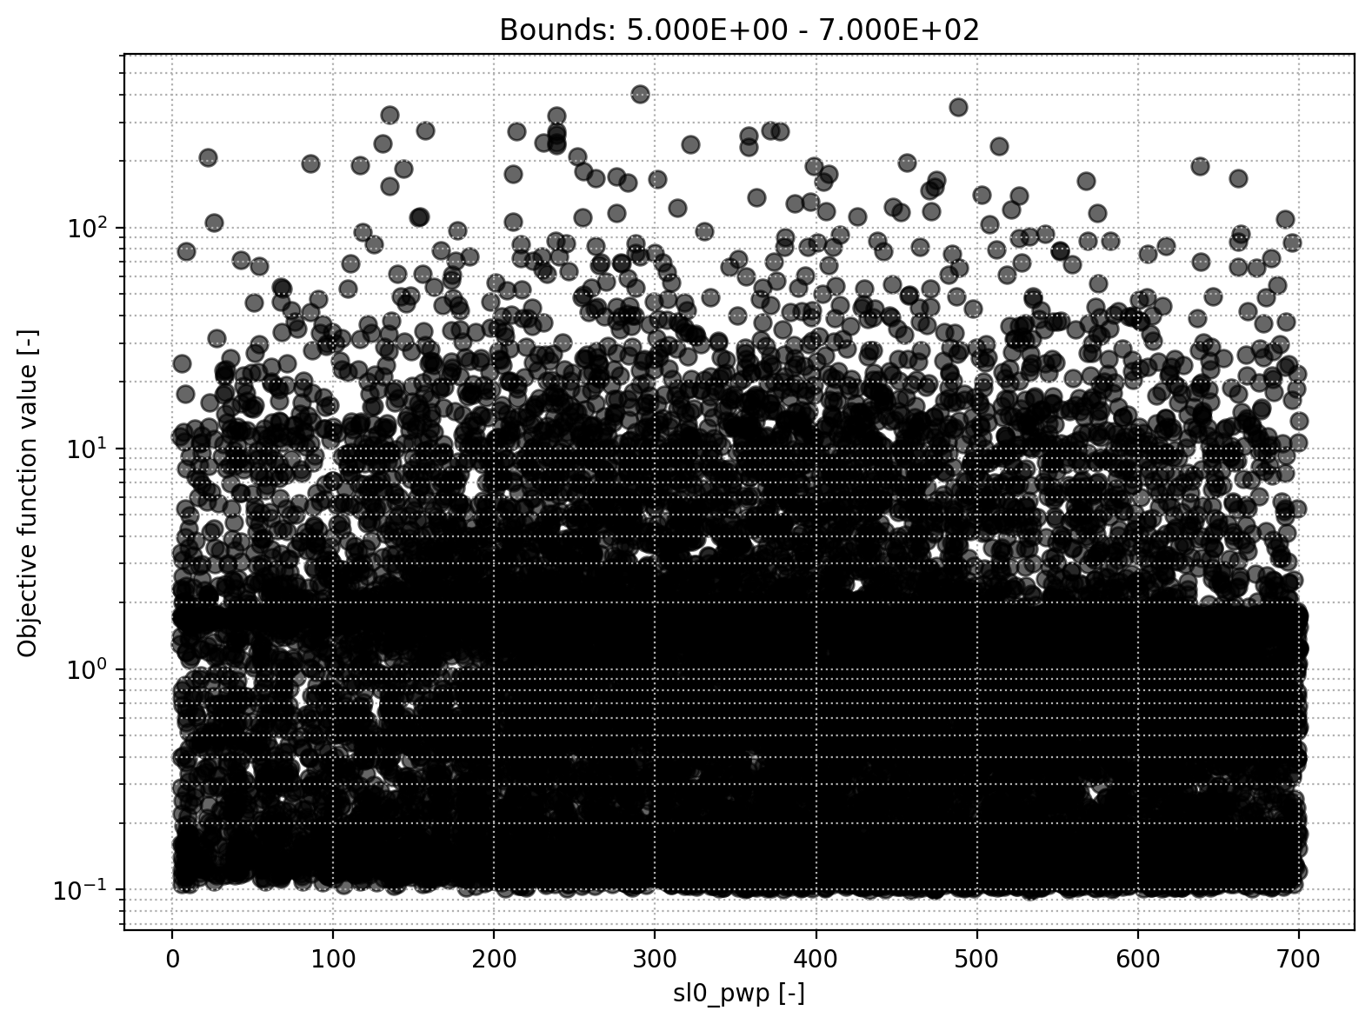
Soil module
Soil initial moisture
Soil field capacity
Soil permanent willting point
Soil beta

Slide 8
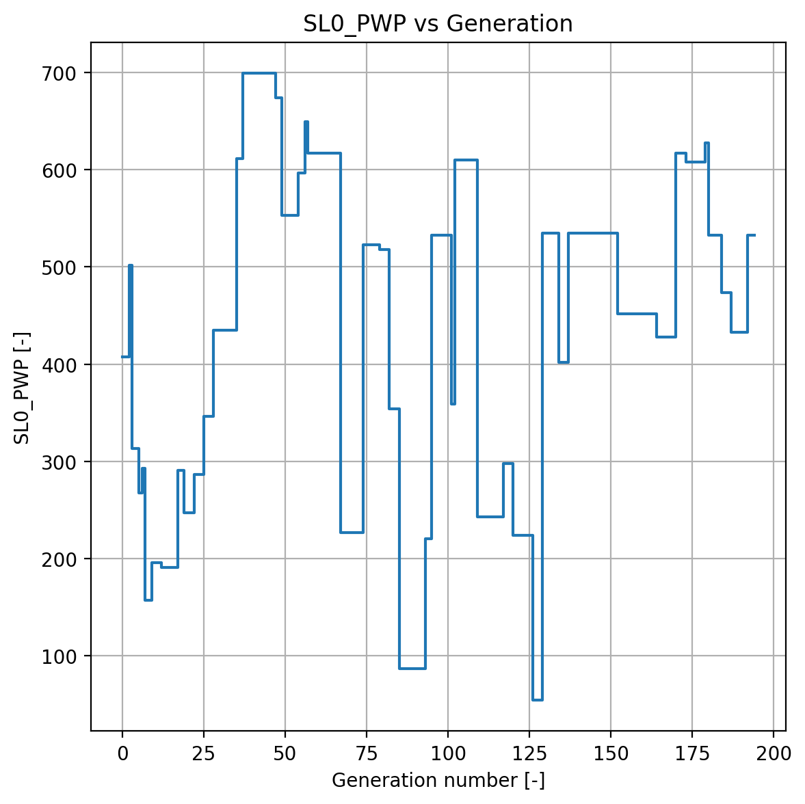
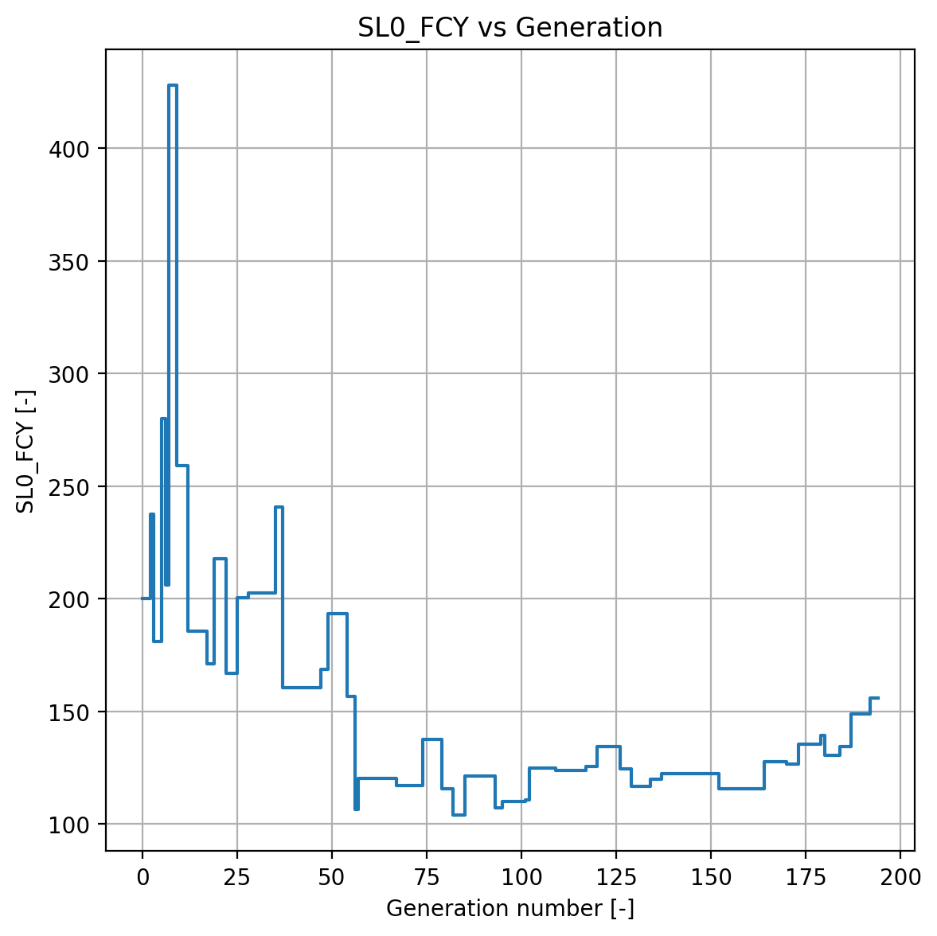
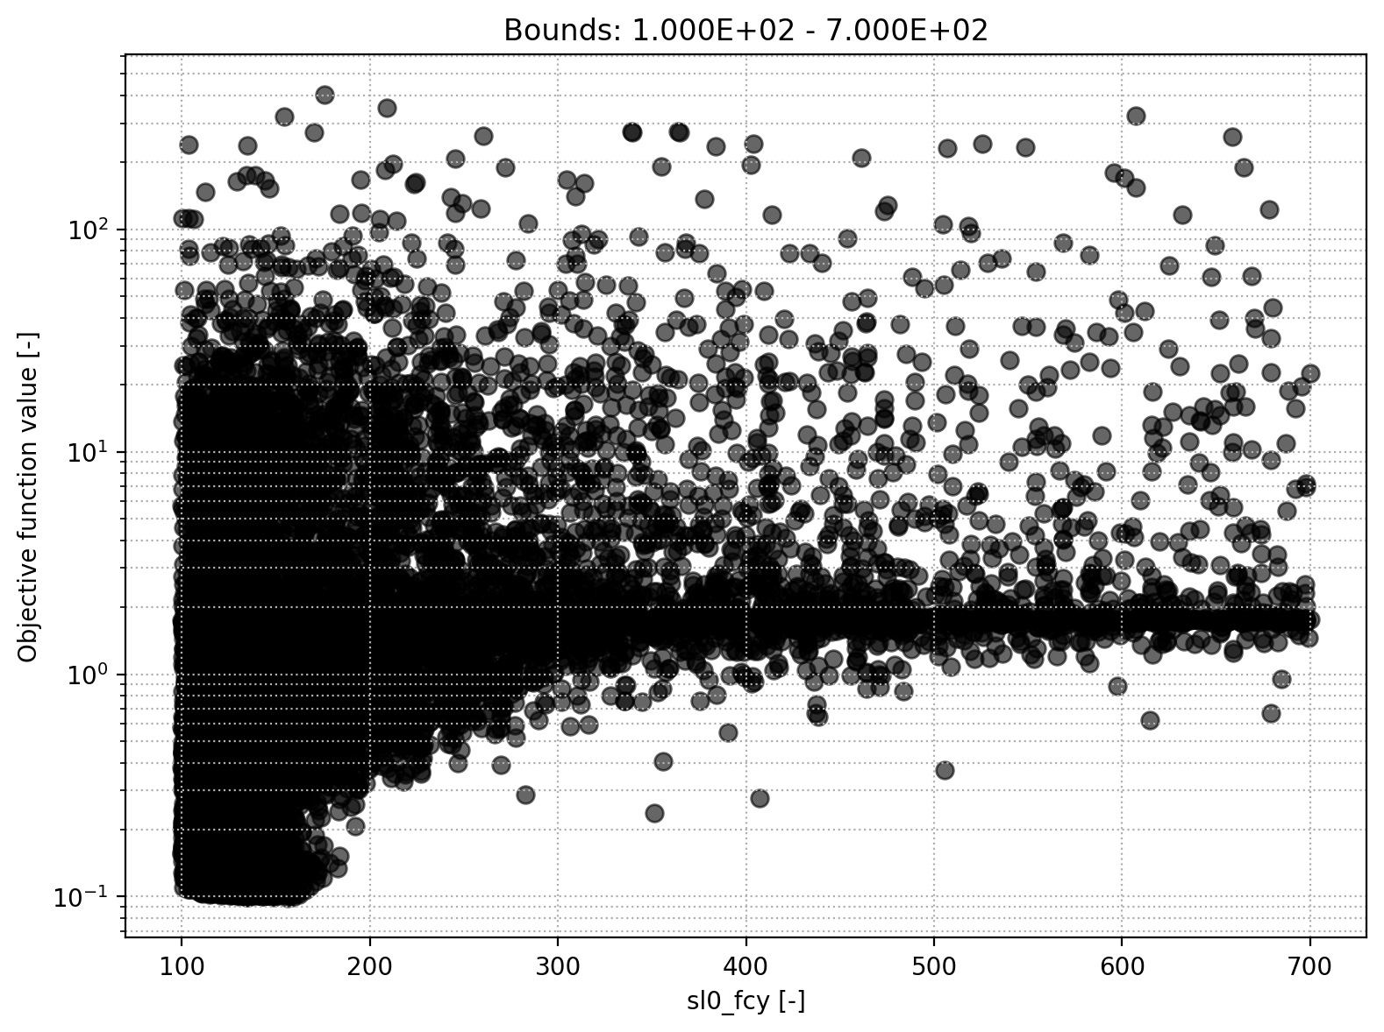
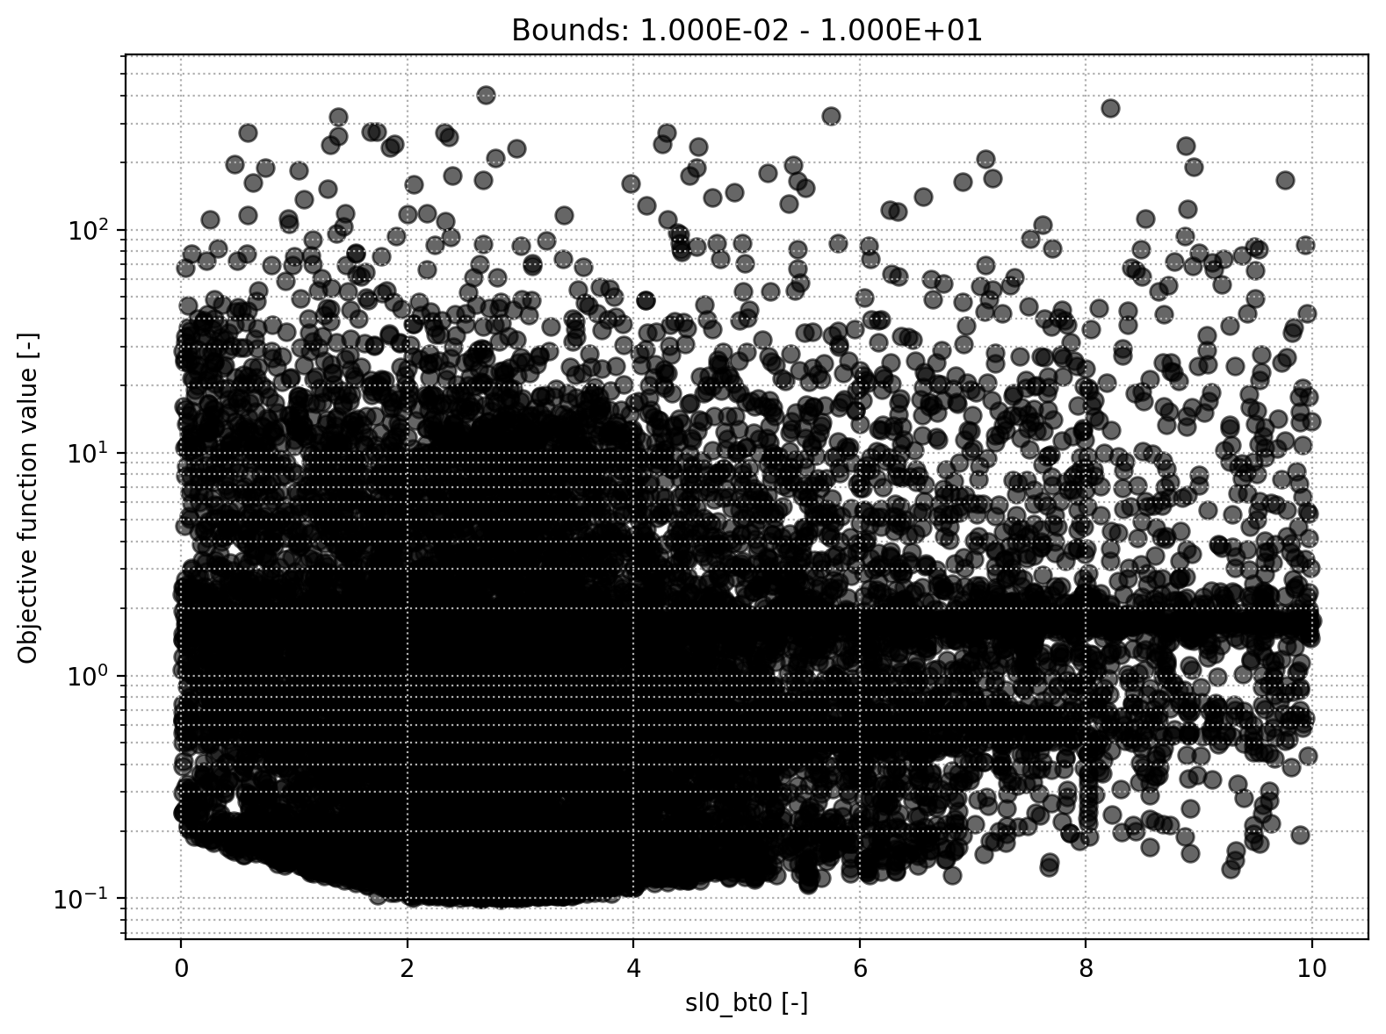
Soil module
Soil beta
Soil field capacity

Slide 9
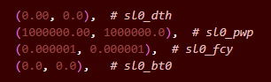
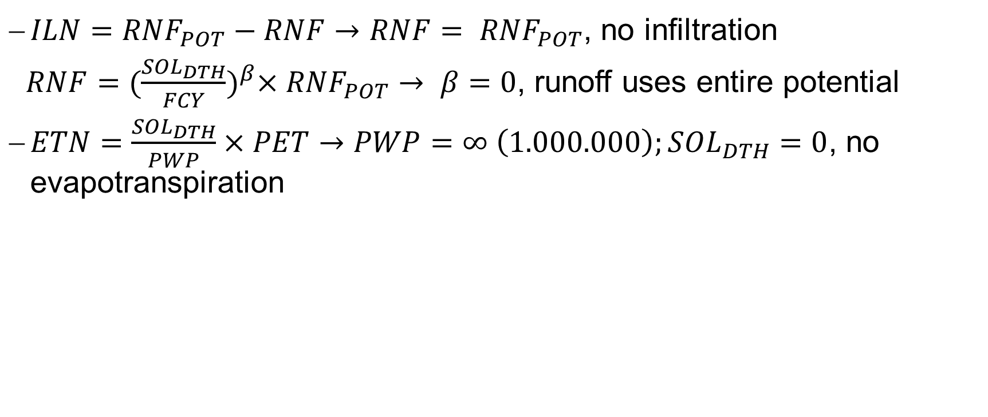
Equations
$ILN={RNF}_{POT}−RNF→RNF= {RNF}_{POT}$, no infiltration
$RNF{=(\frac{{SOL}_{DTH}}{FCY})}^{β}×{RNF}_{POT}→ β=0$, runoff uses entire potential
$ETN=\frac{{SOL}_{DTH}}{PWP}×PET→PWP=∞ \left(1.000.000\right);{SOL}_{DTH}=0$, no evapotranspiration

Slide 10
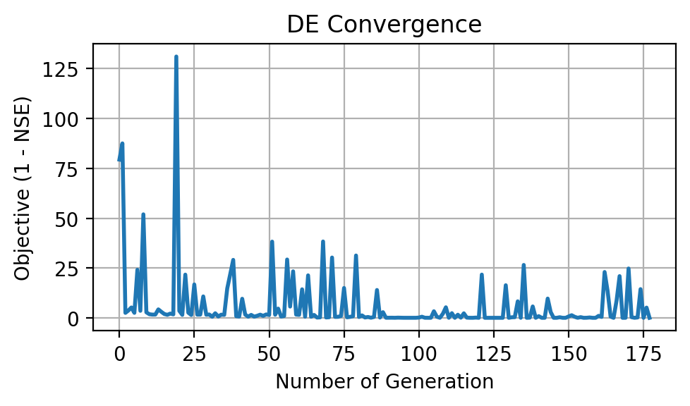
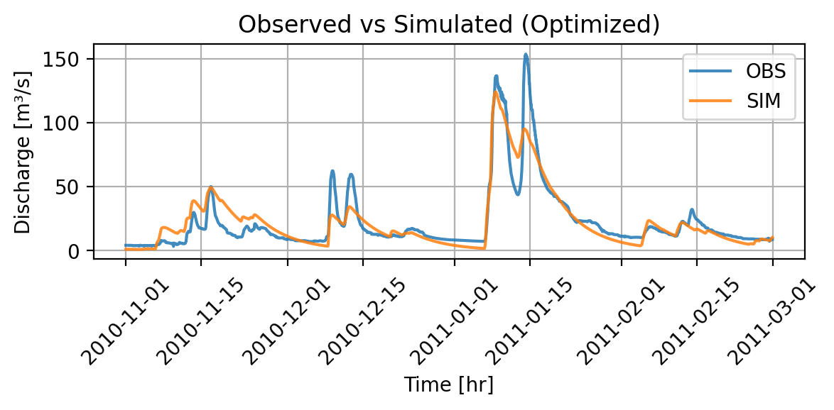
Results
NSE = 0.843
Slightly worse NSE
Implies no big impact of Evapotranspiration and Infliltration
Model runtime = 3.85 minutes
Max iterations: Fluctuating

Slide 11
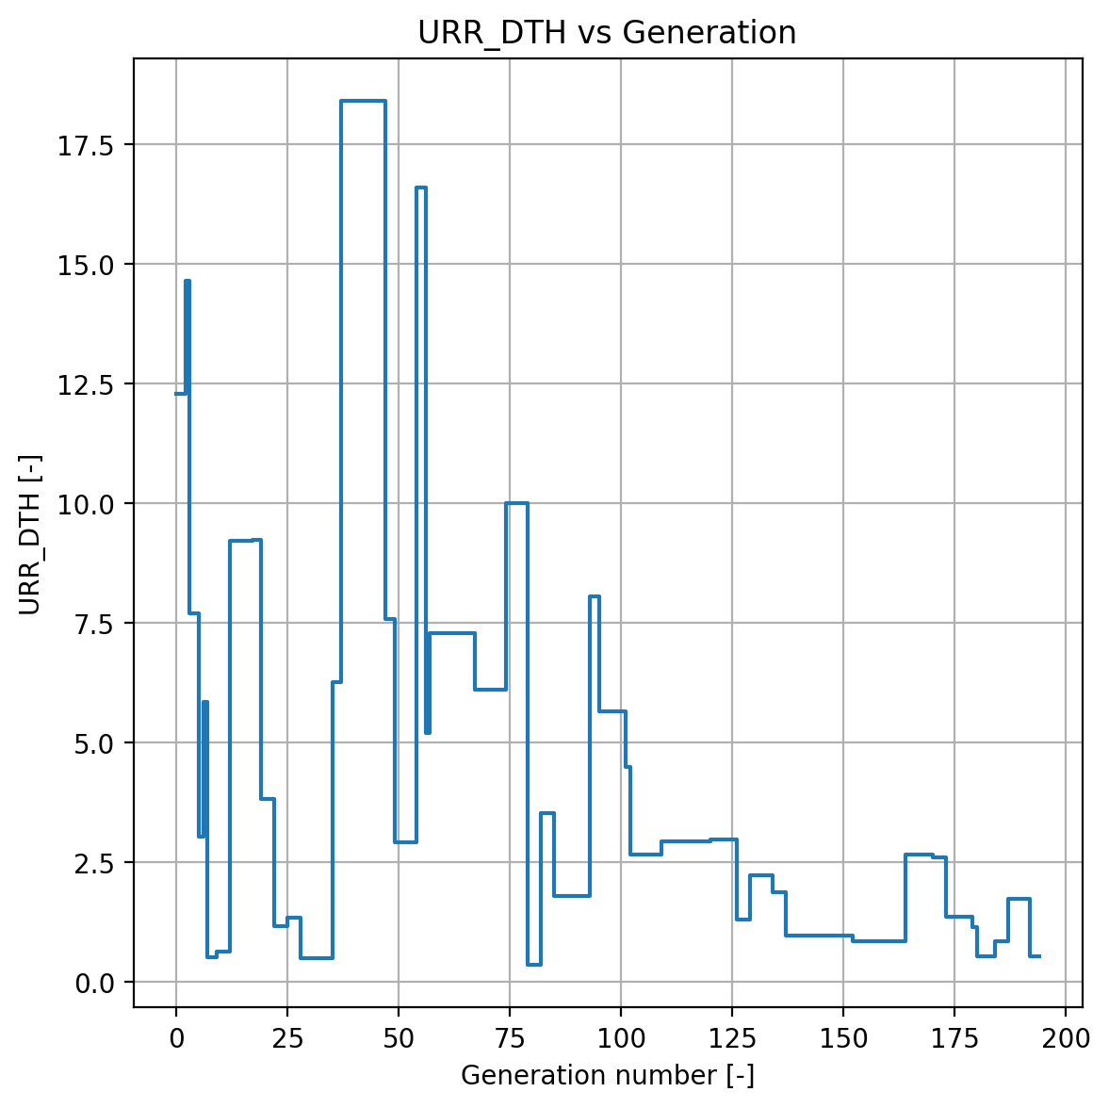
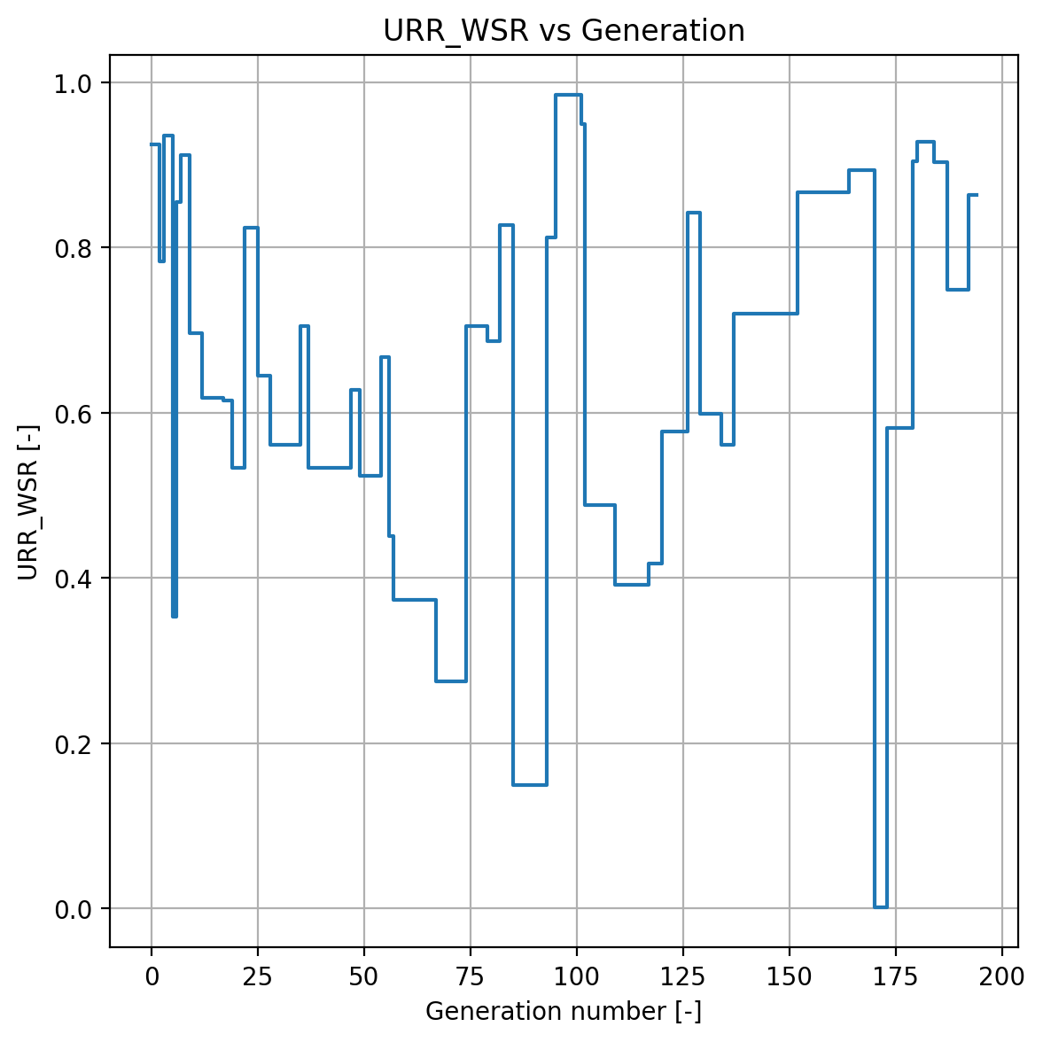
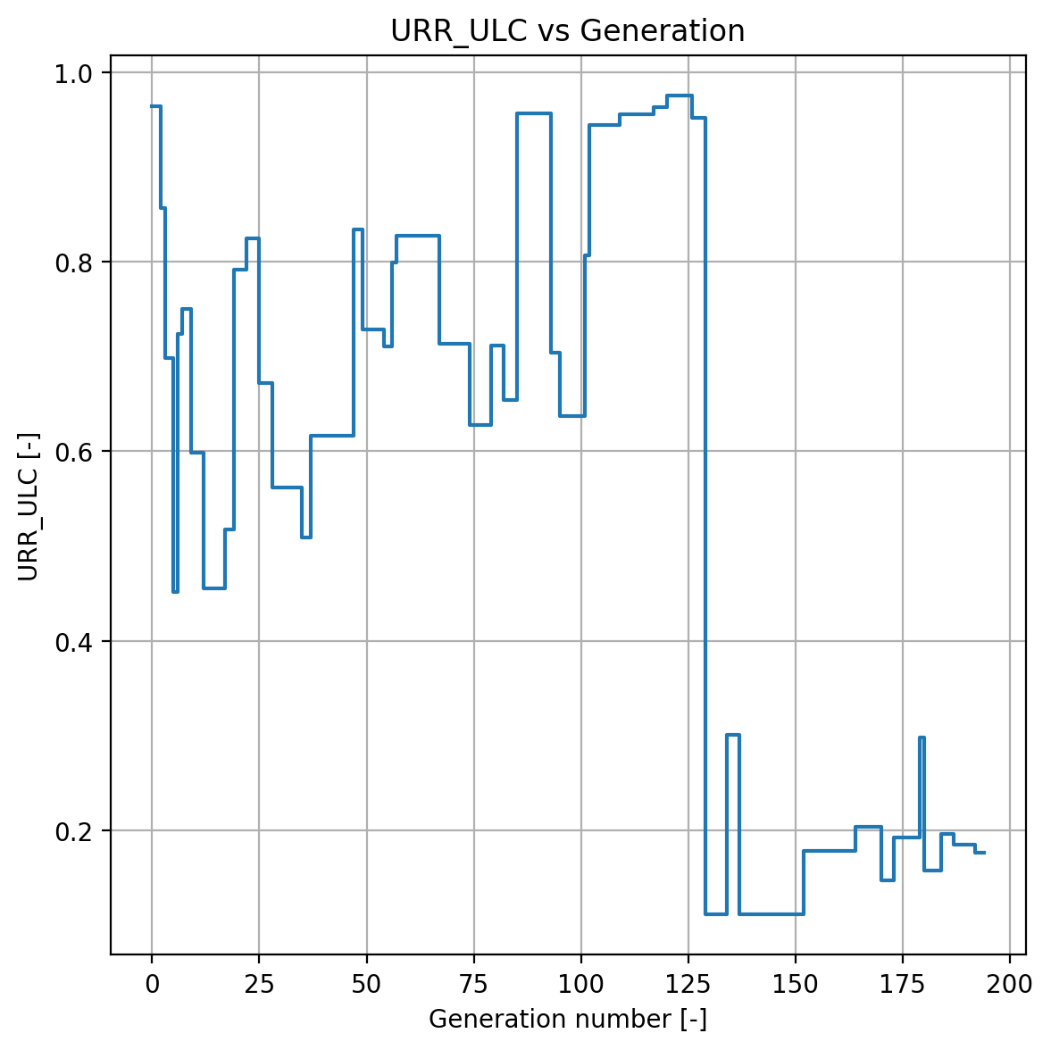
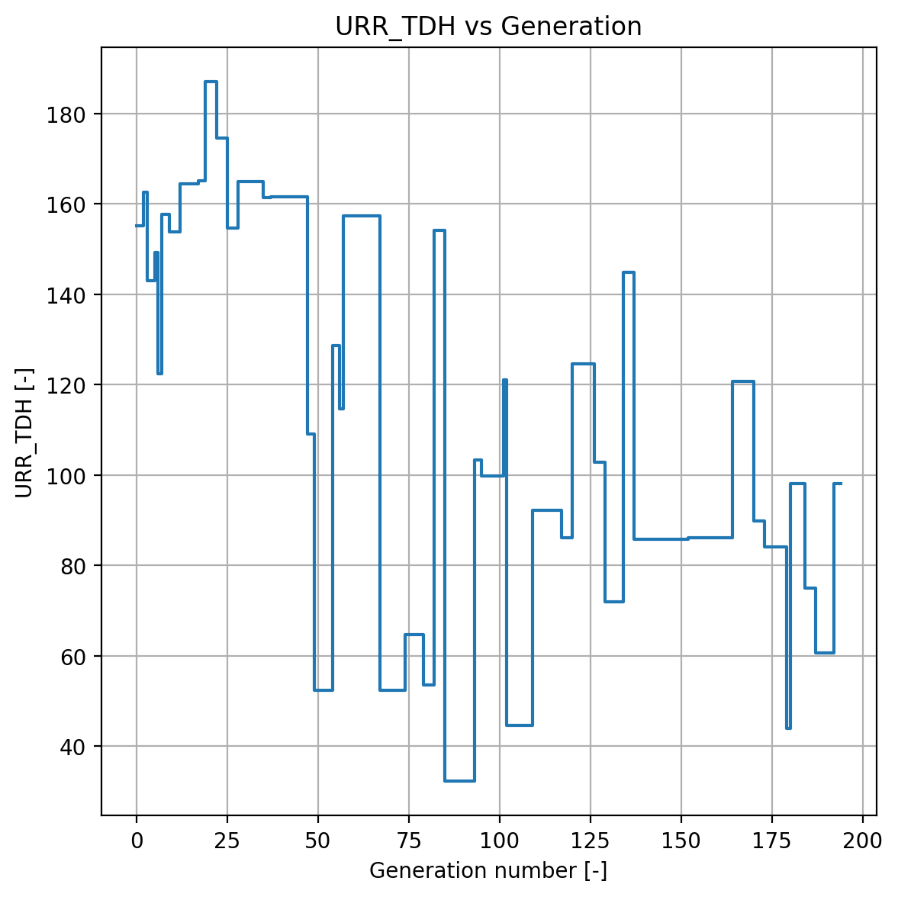
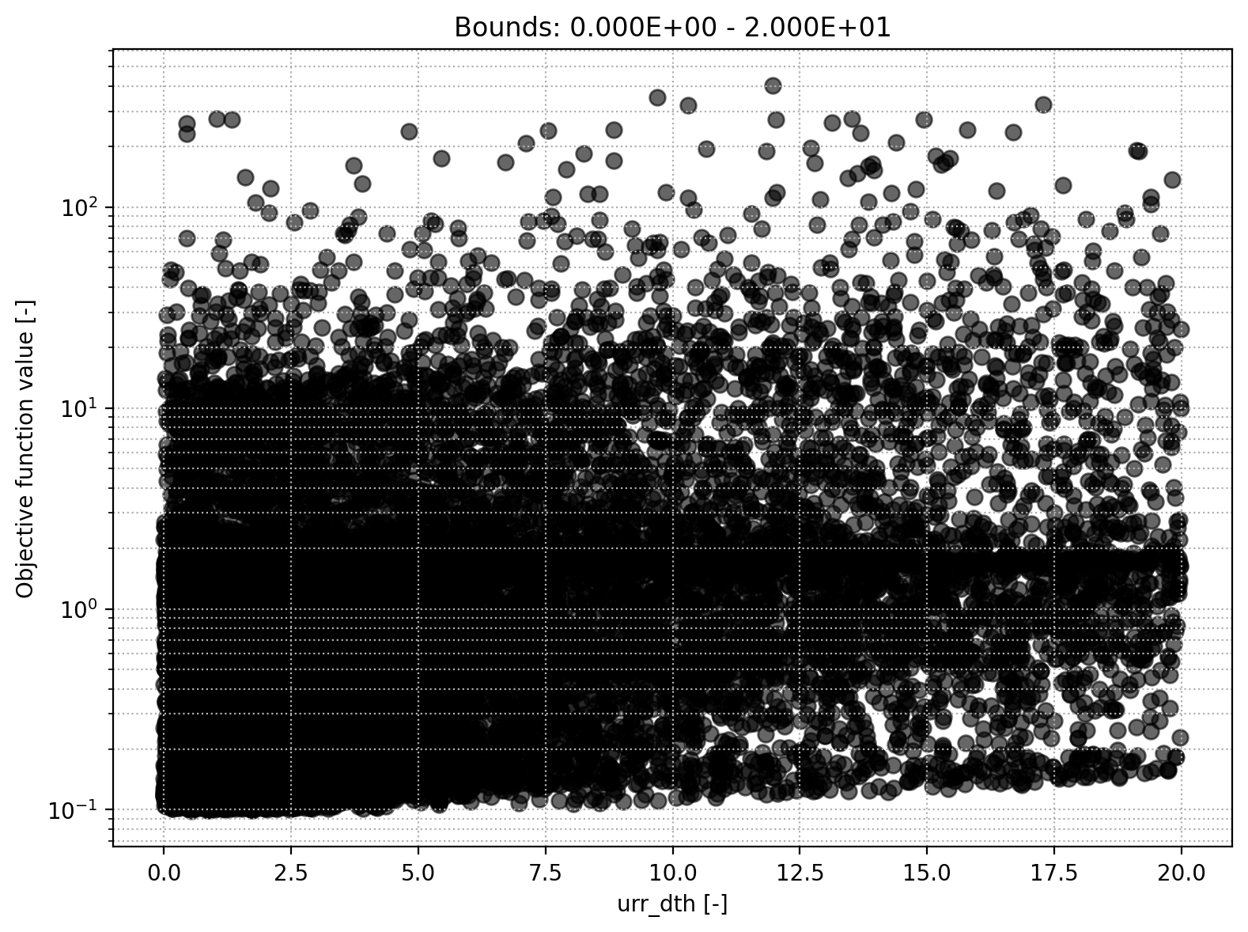
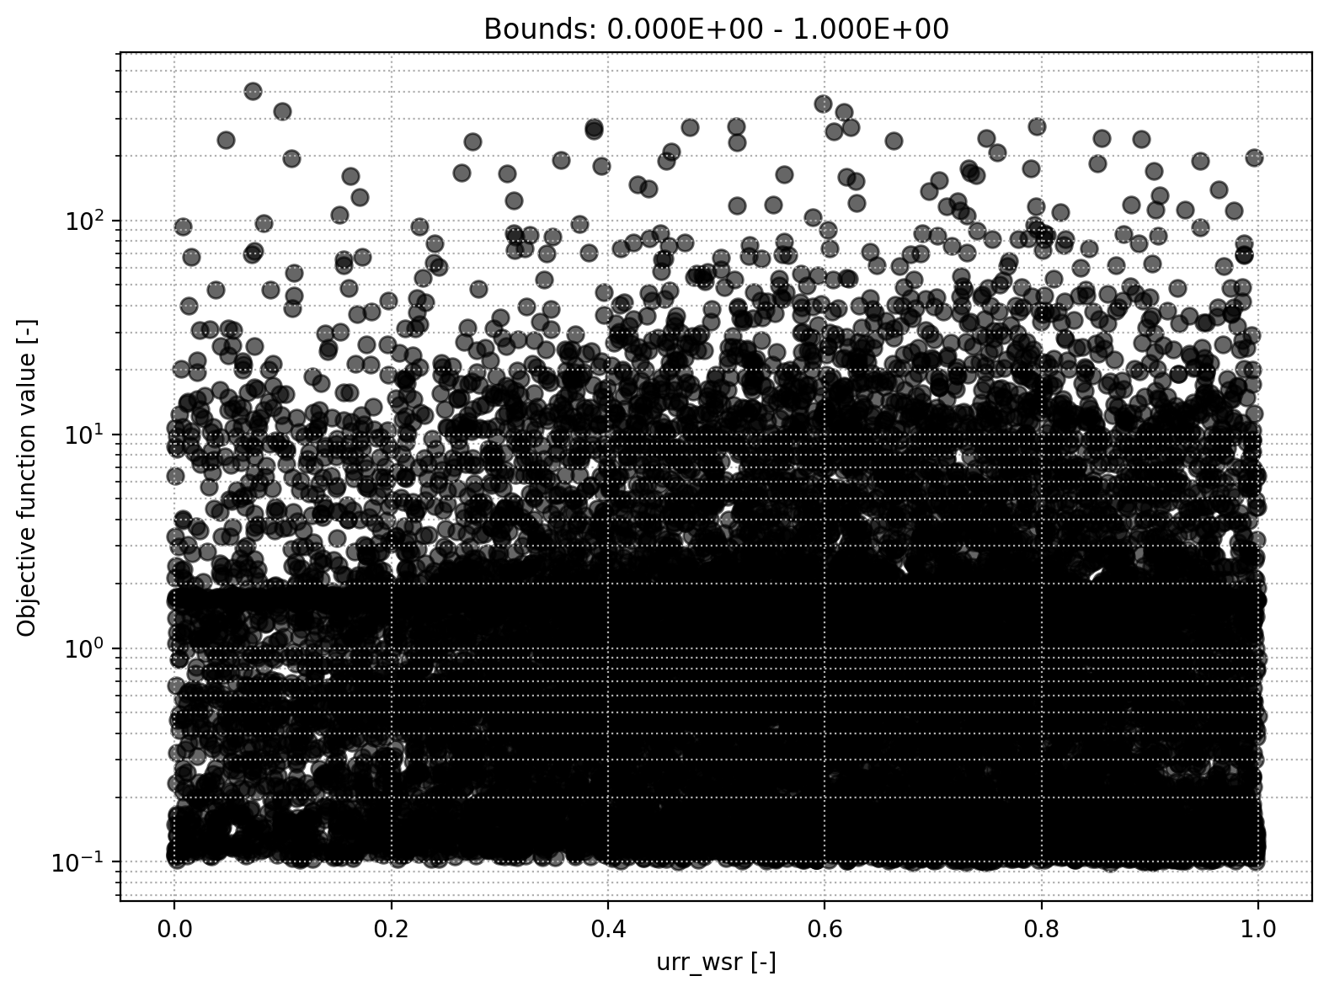
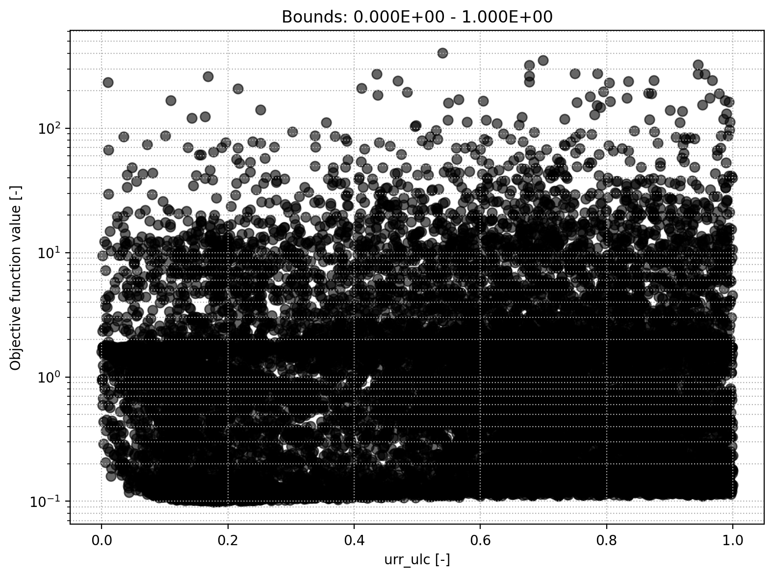
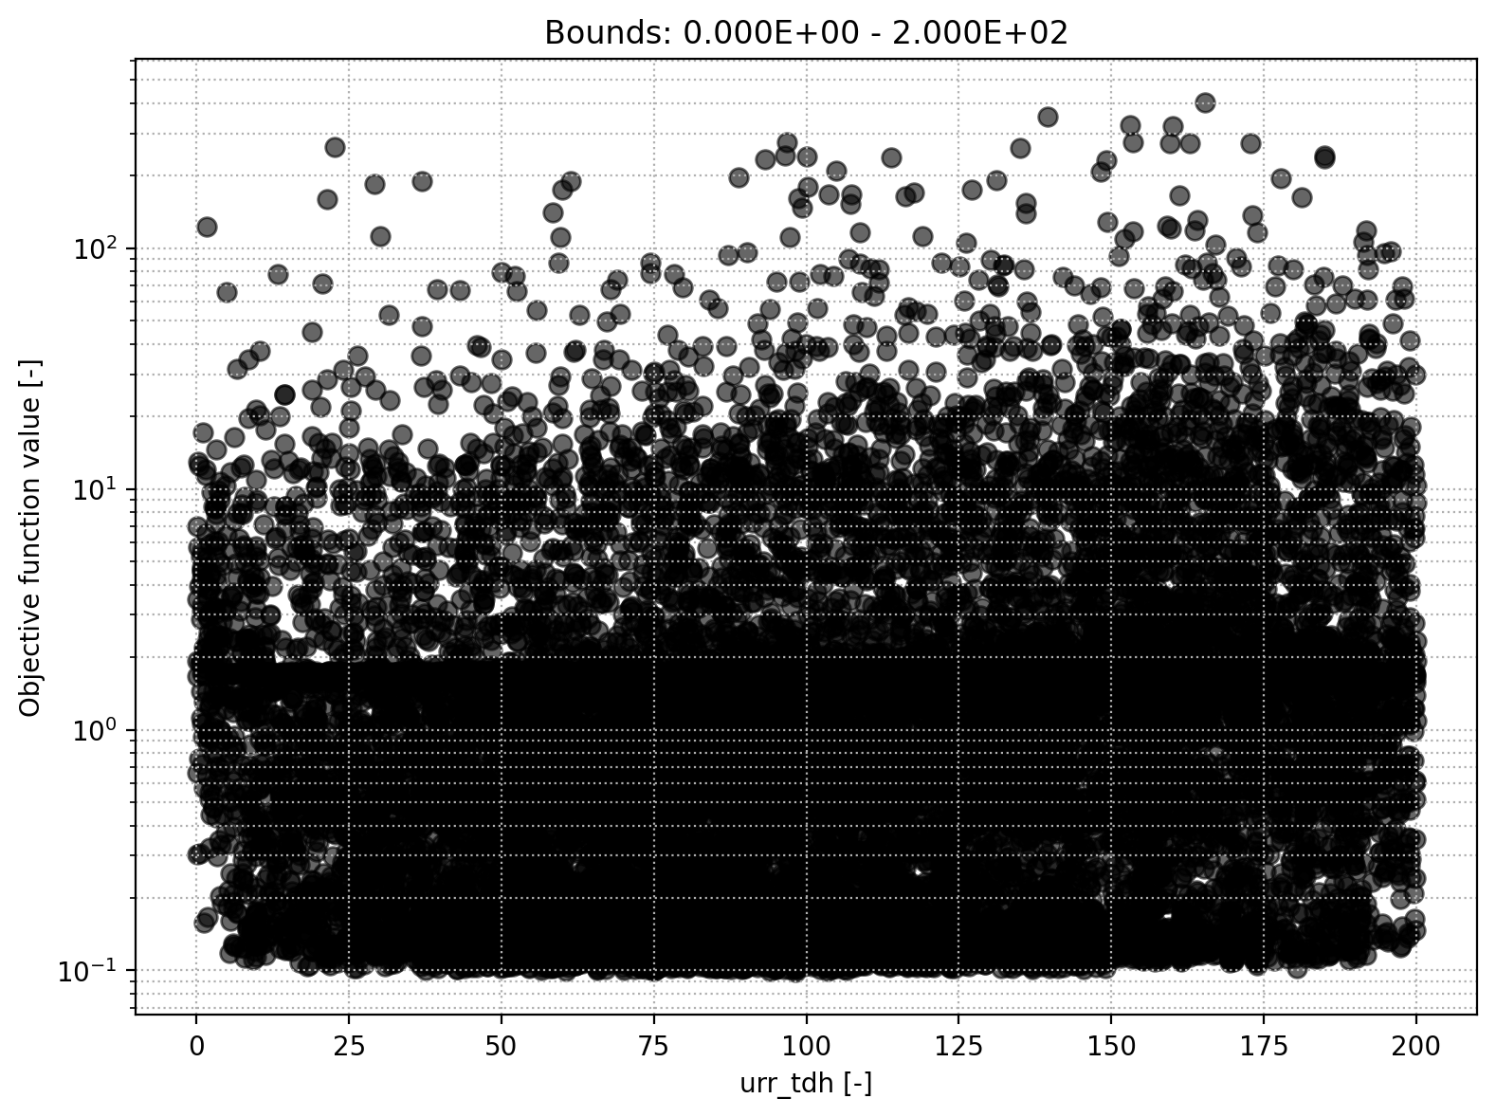
URR module
Storage initial upper reservoir
Upper-ers. runoff split ratio
Percolation coefficient upper-to-lower
Upper-res. threshold depth

Slide 12
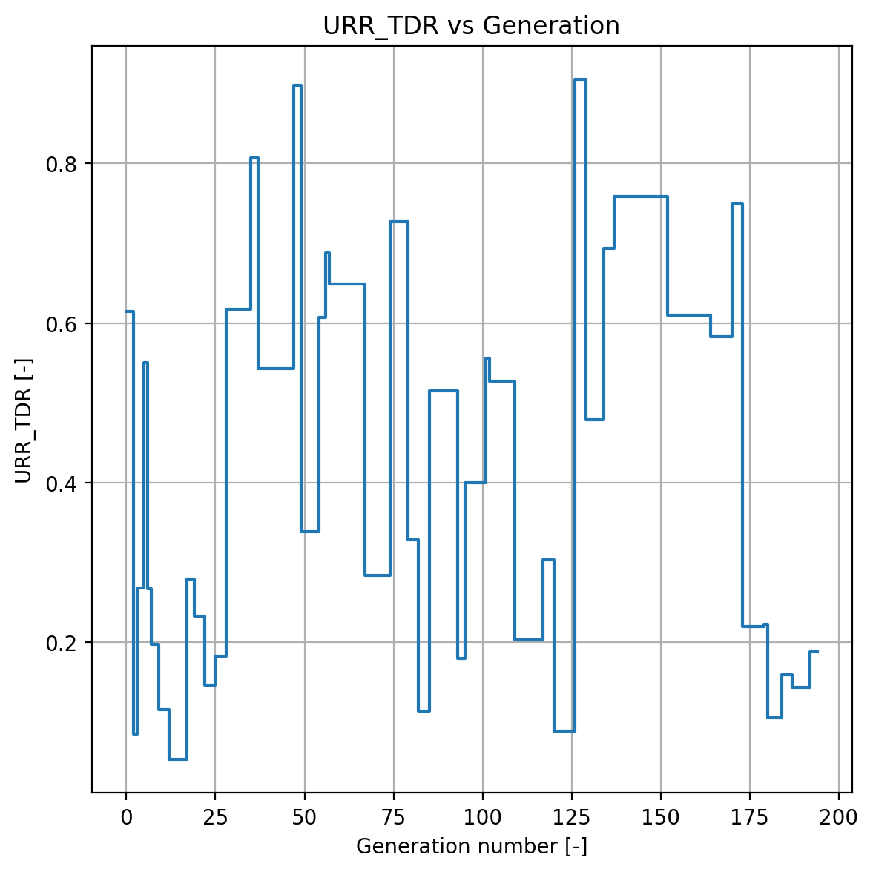
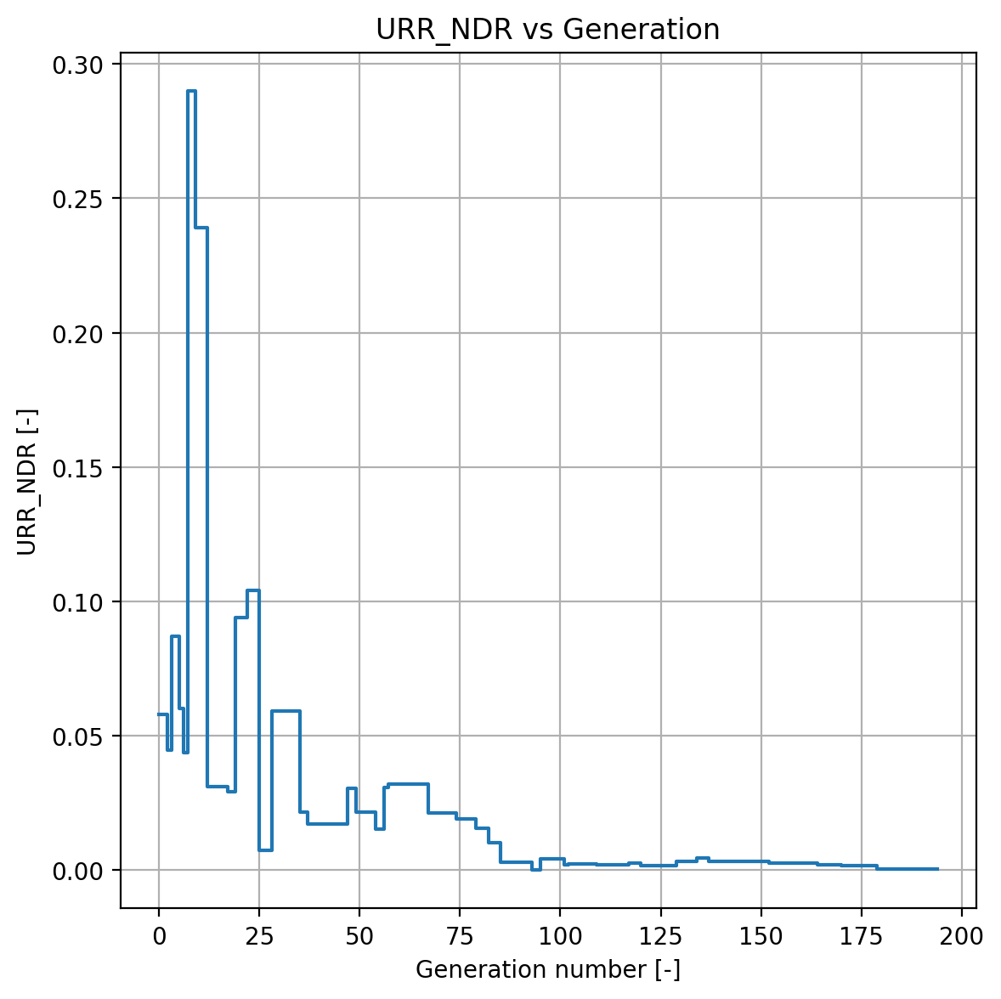
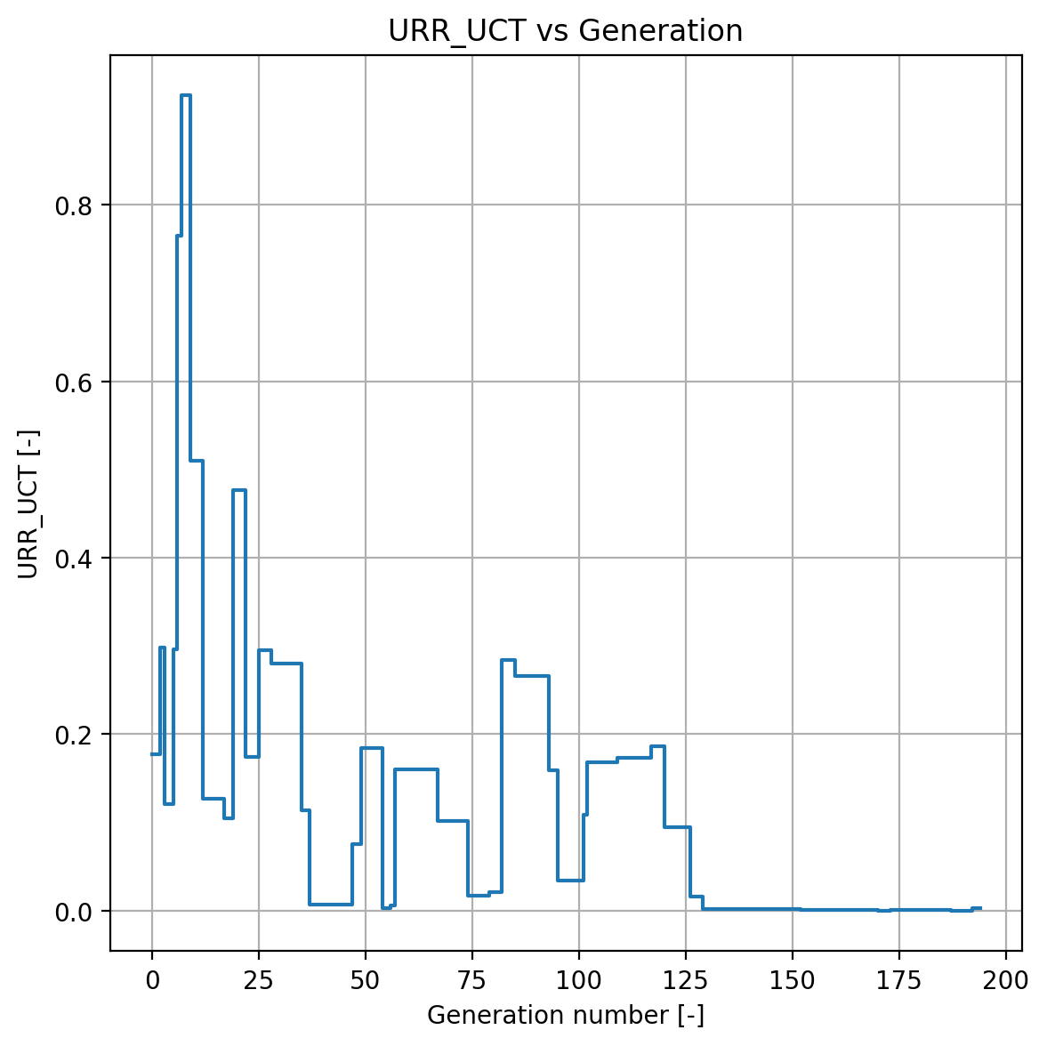
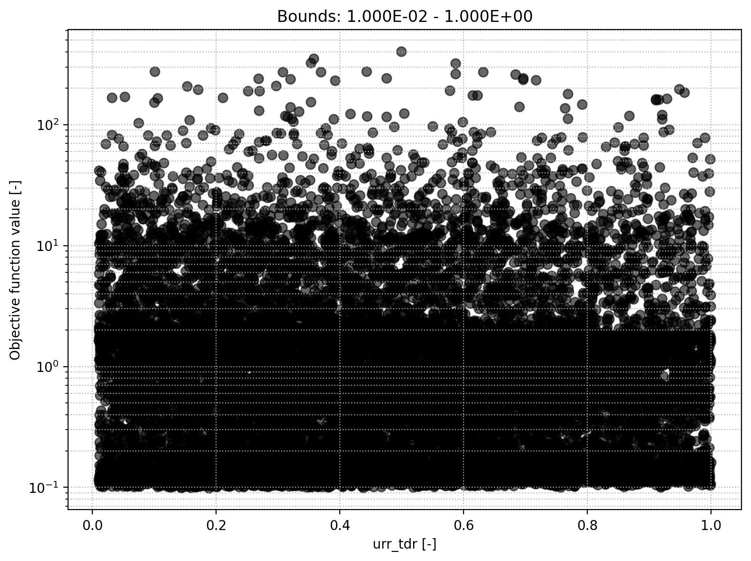
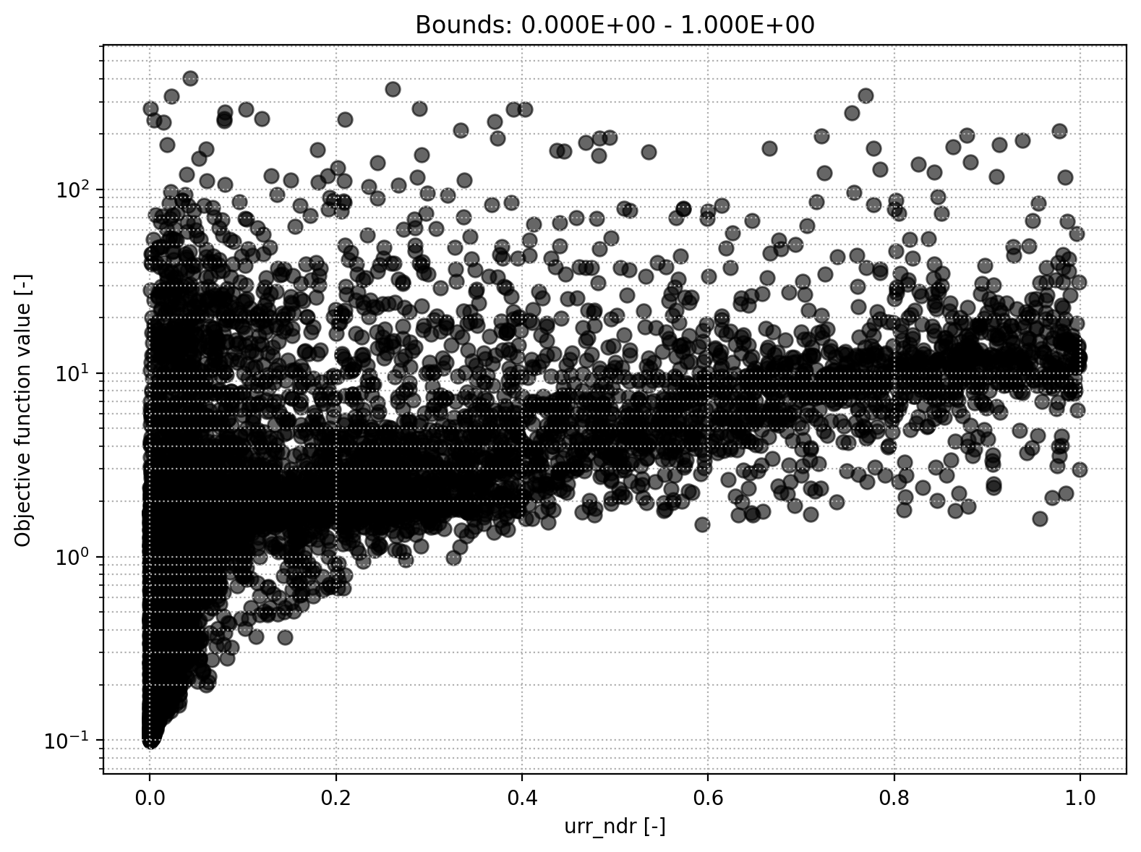
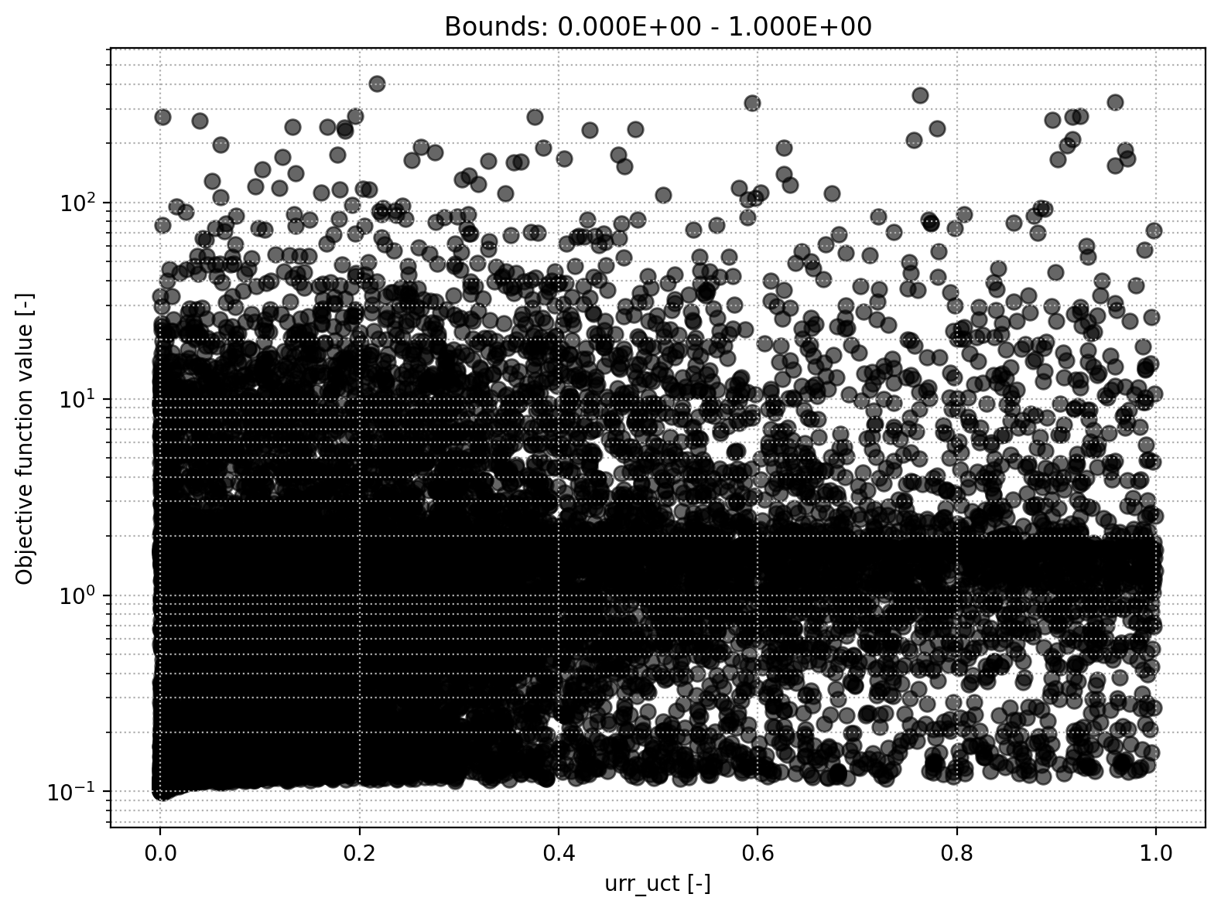
URR module
Upper-res. threshold coefficient
Upper-res. discharge to runoff coefficient
Upper-res. runoff coefficient

Slide 13
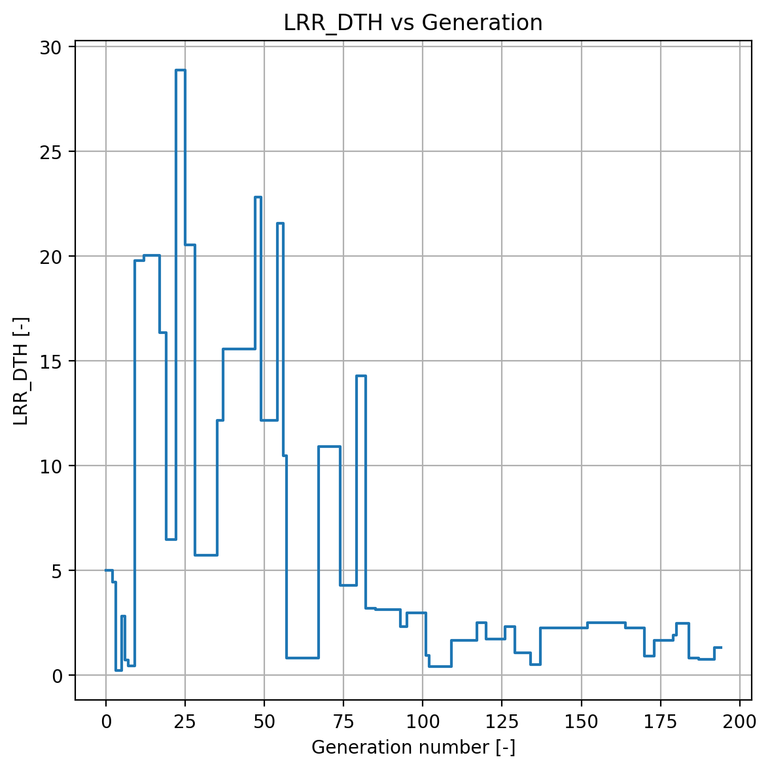
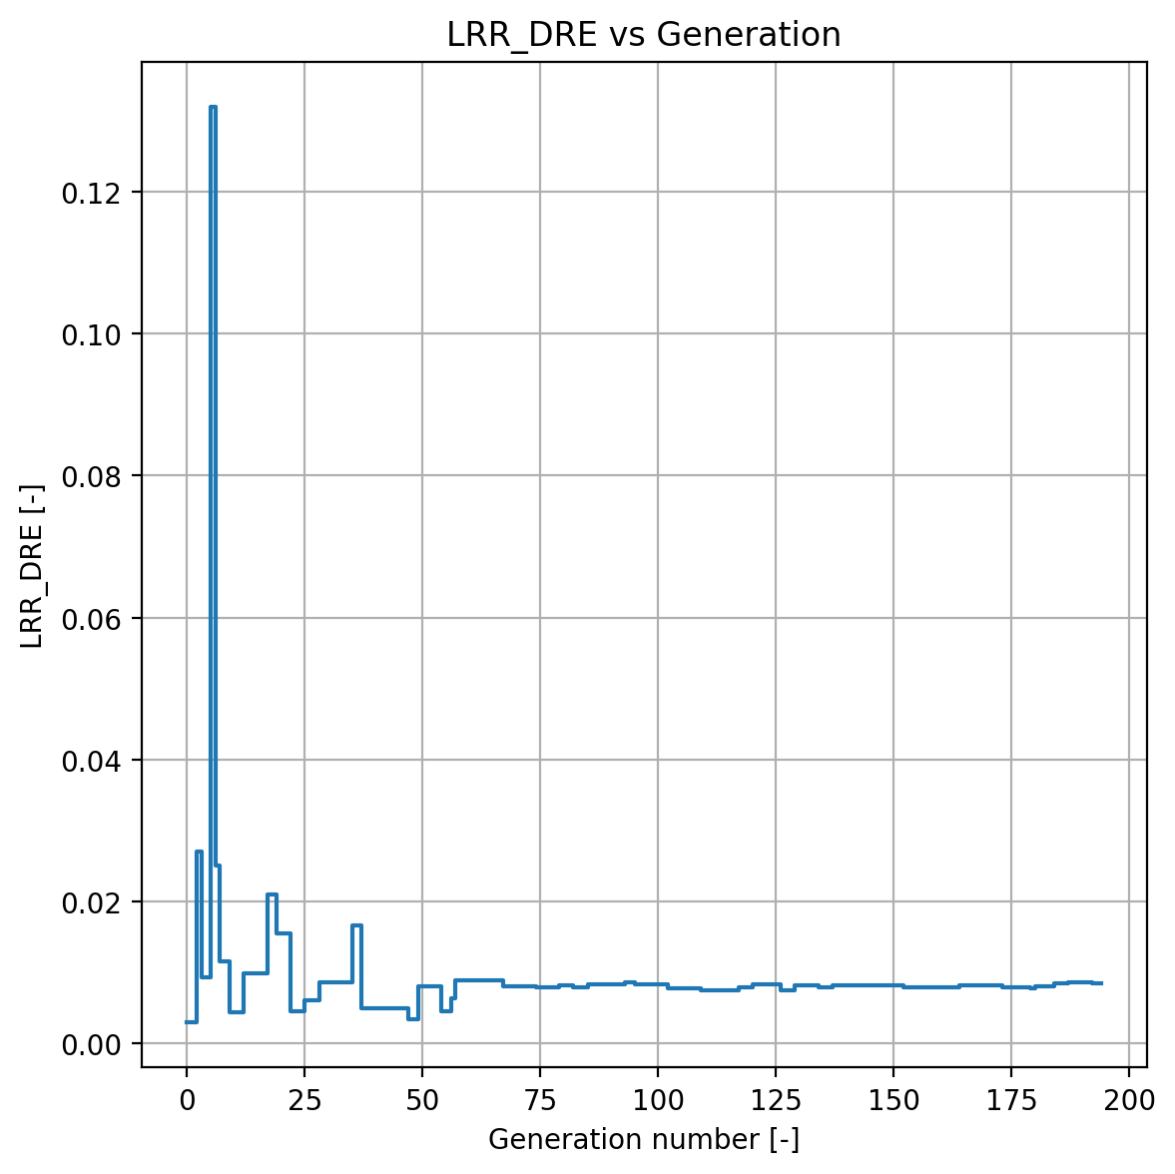
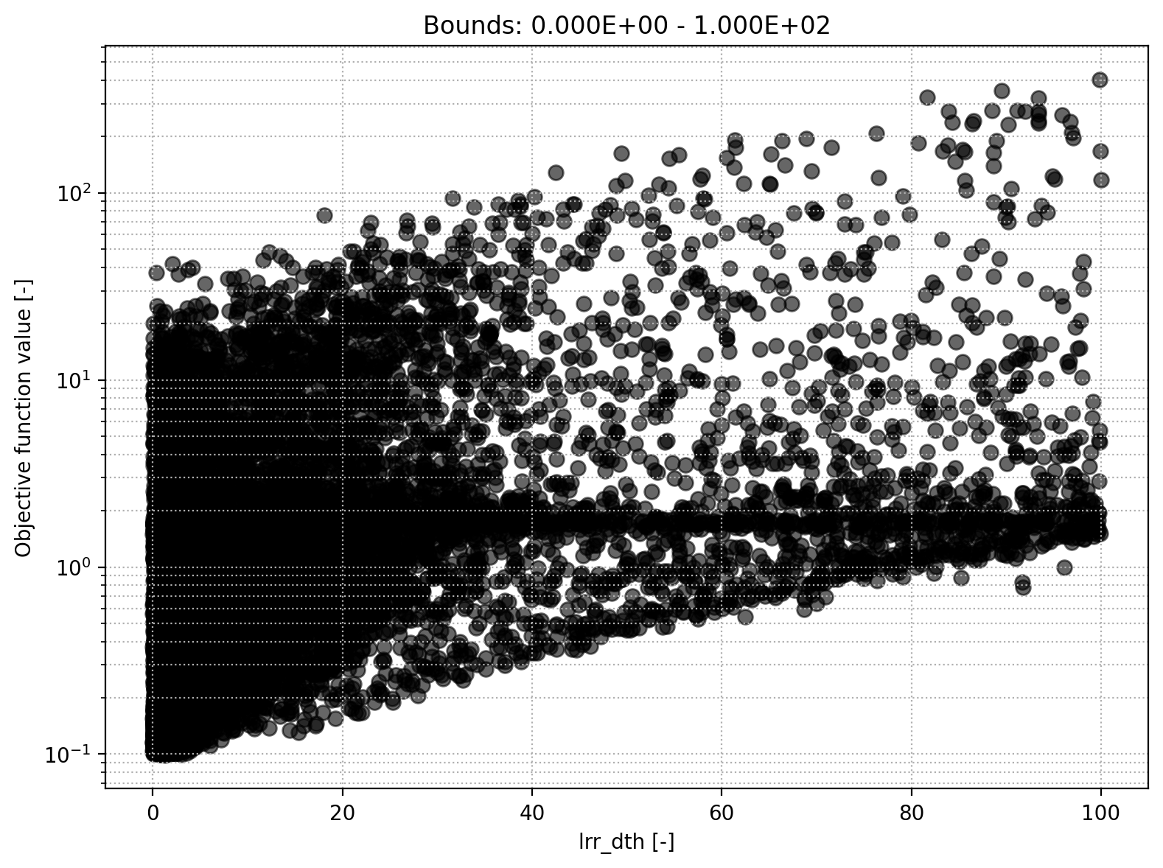
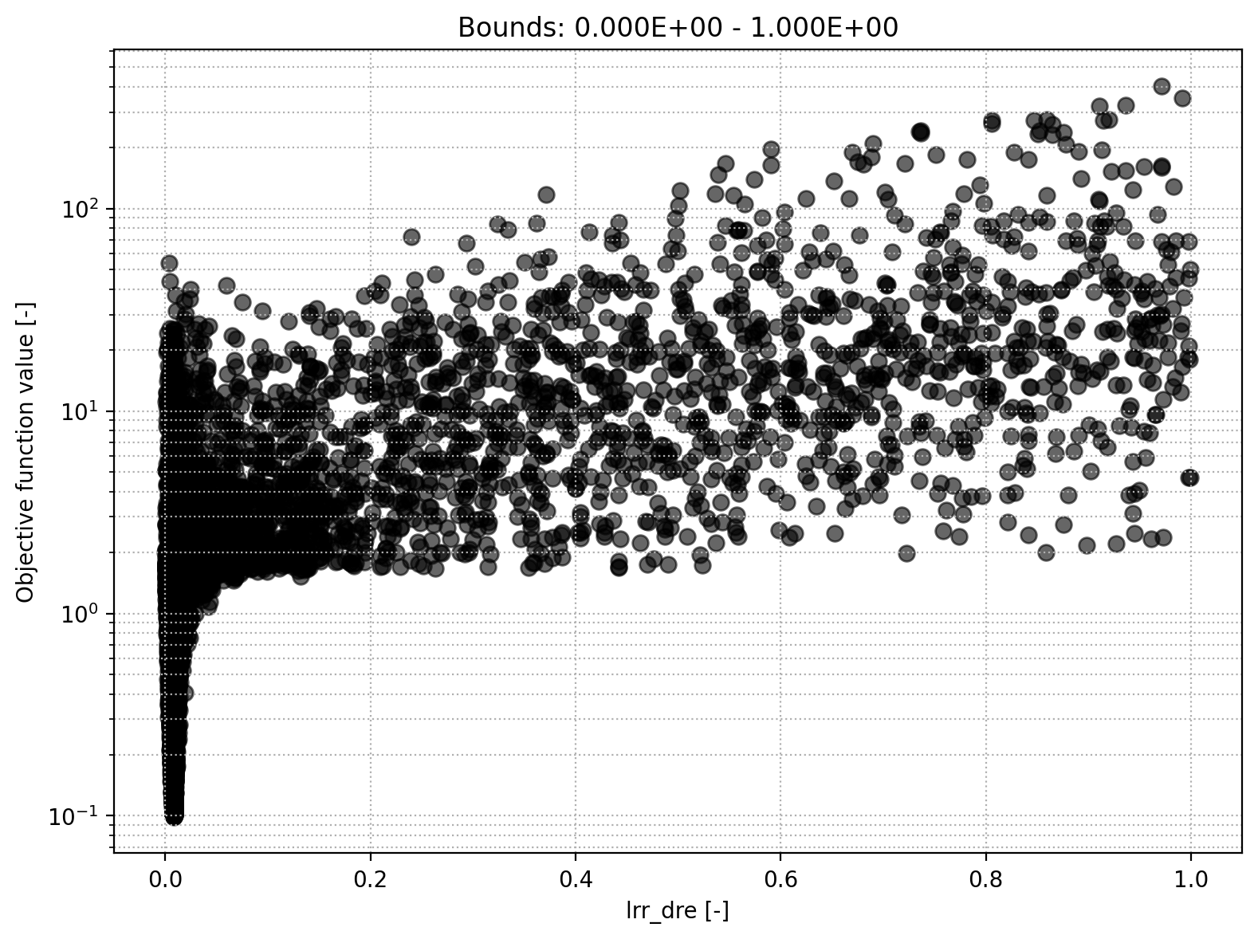
LRR module
Storage initial lower reservoir
Discharge rate

Slide 14


LRR module
Lower-res. runoff coefficient

